Slide 1
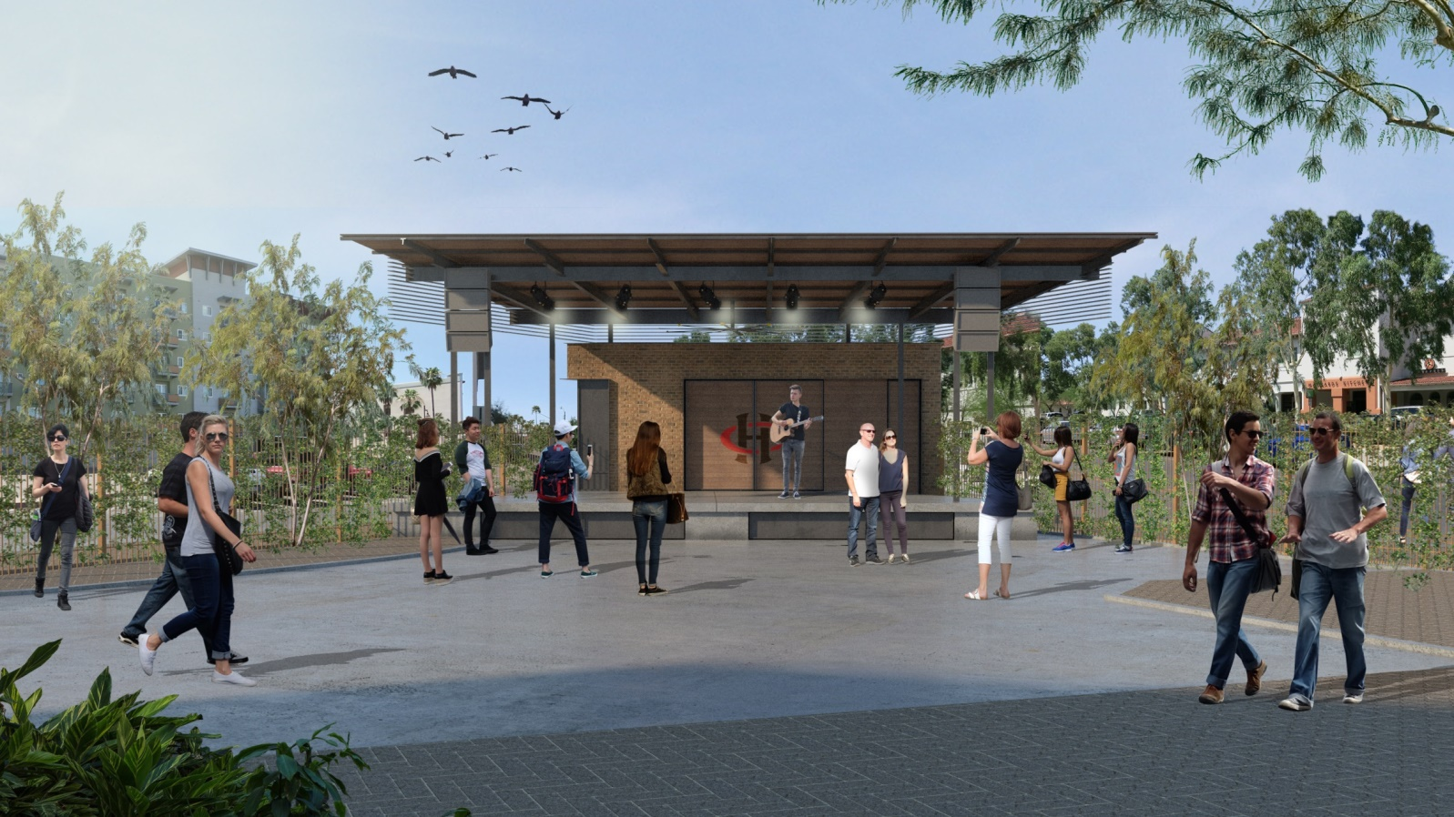
NEW STAGE & STORAGE BUILDING
HOTEL CONGRESS
311 E CONGRESS TUCSON AZ 85701

Slide 2
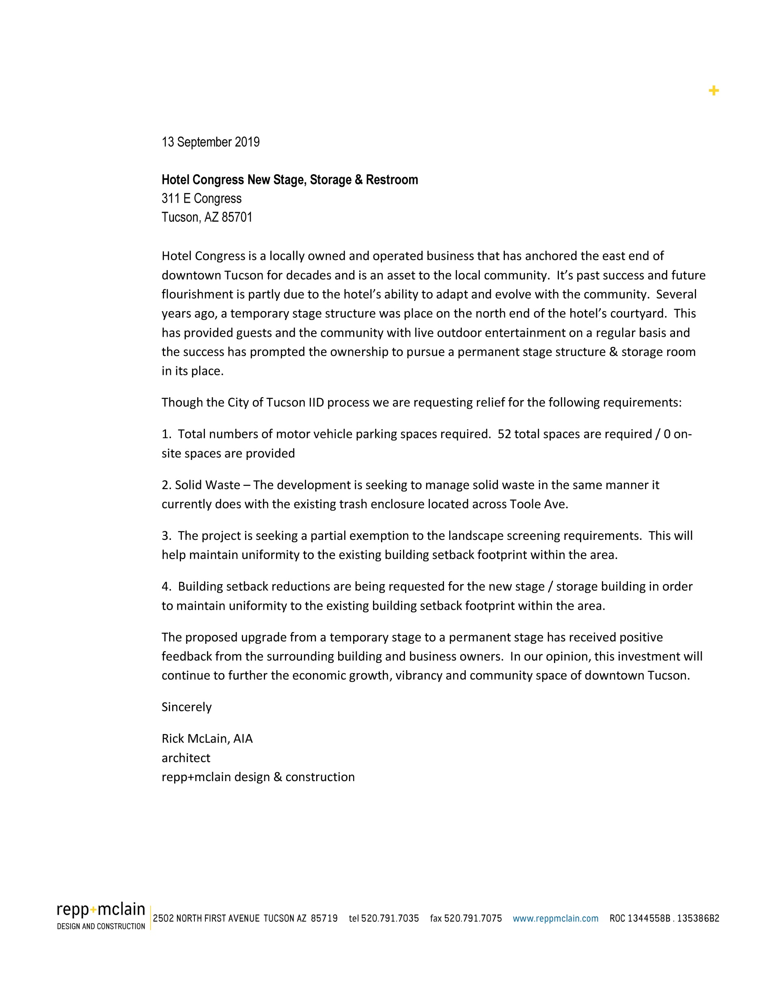

Slide 3
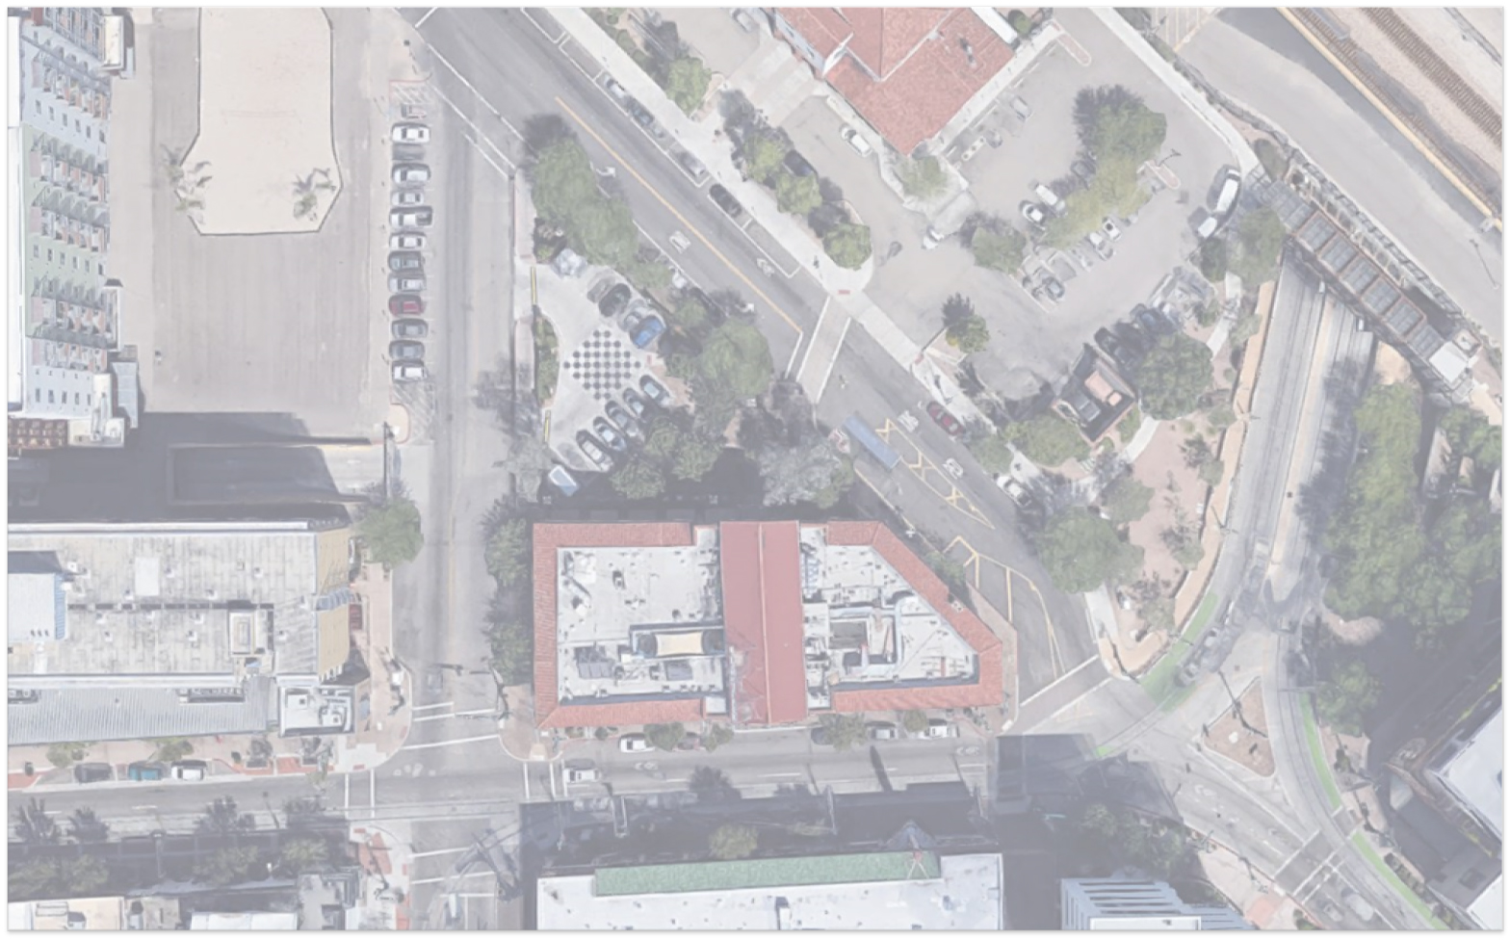
5
6
N. TOOLE AVE
N. FIFTH AVE
2
N. FOURTH AVE
SITE
1
7
9
4
8
3
E. CONGRESS ST
AERIAL & PHOTO KEY

Slide 4
01 North Fifth Avenue Elevations
02 North Toole Avenue Elevations
03 E Congress St. Elevations
SITE PHOTOS

Slide 5
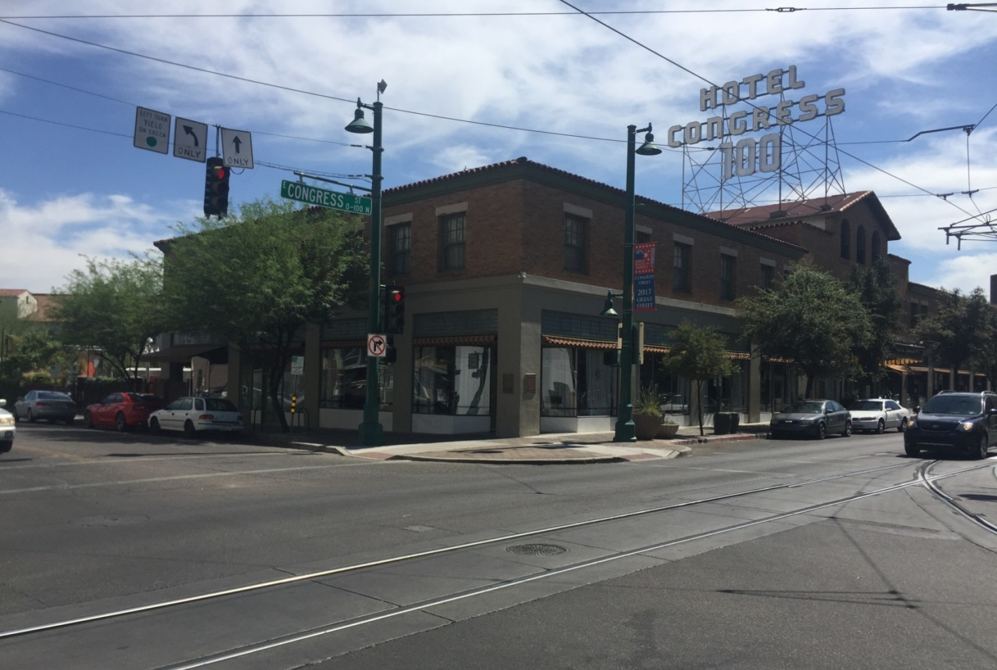
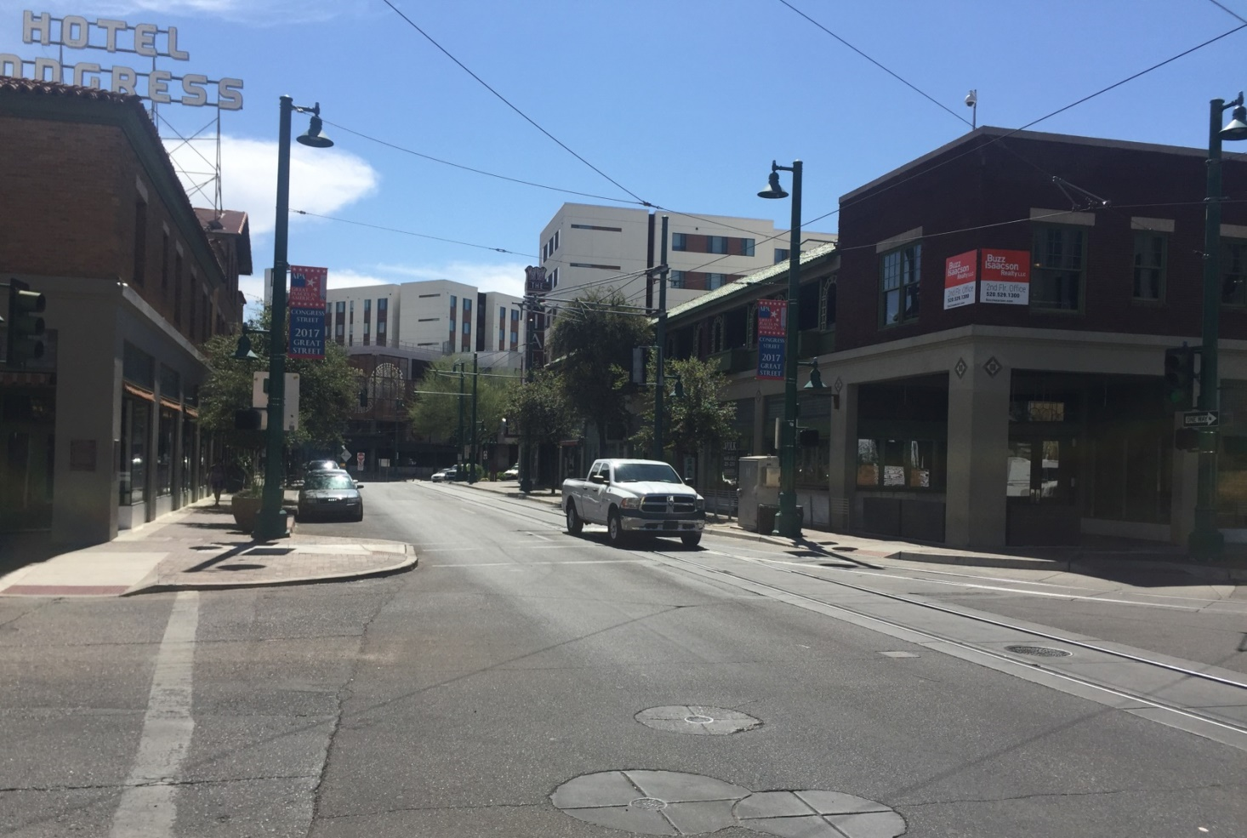
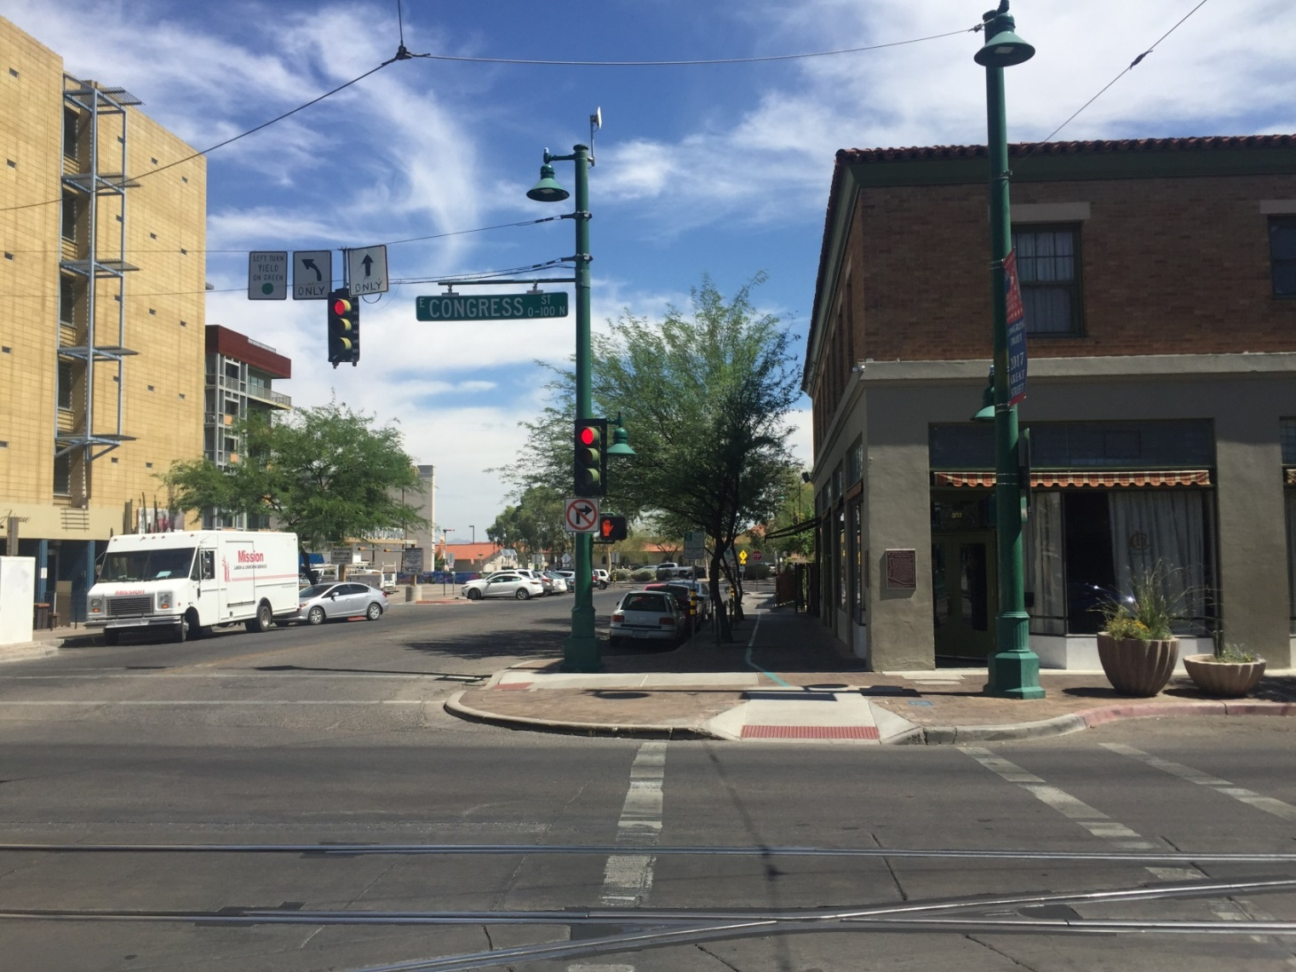
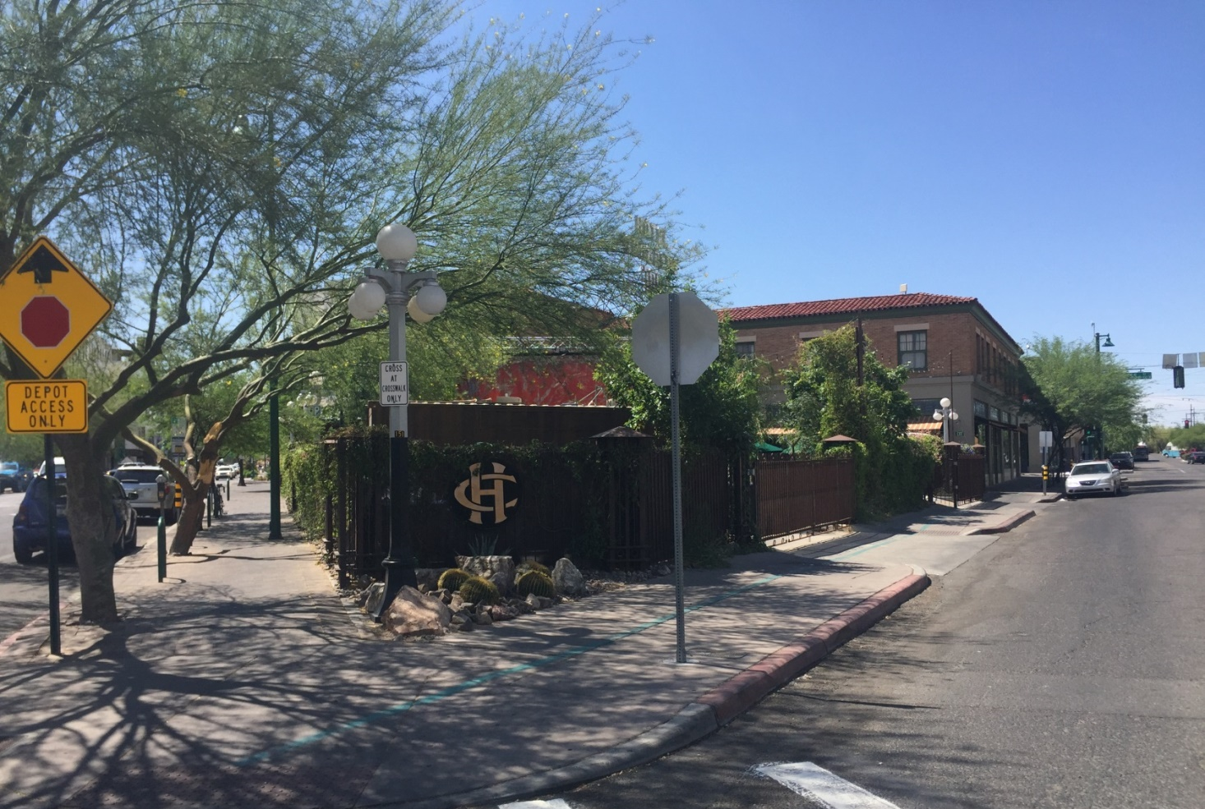
04 Site looking northeast – Congress / Fifth
08 Site looking east– Congress / Fifth
07 Site looking north - Fifth
05 Site looking southeast – Toole / Fifth
SITE PHOTOS

Slide 6
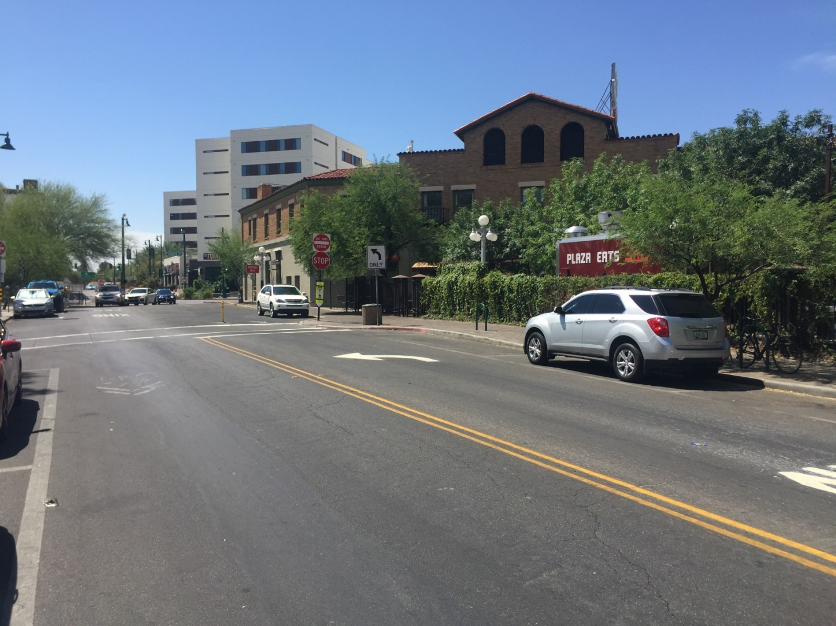
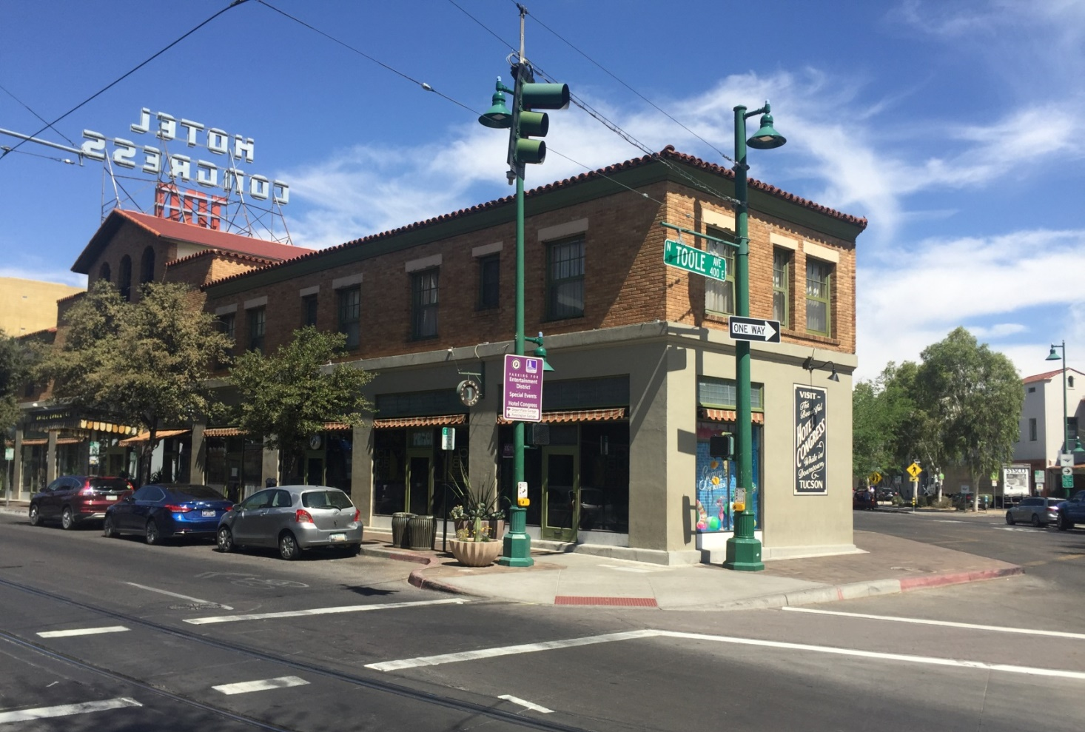
06 Site looking south - Toole
09 Site looking northwest – Toole / Congress
SITE PHOTOS

Slide 7
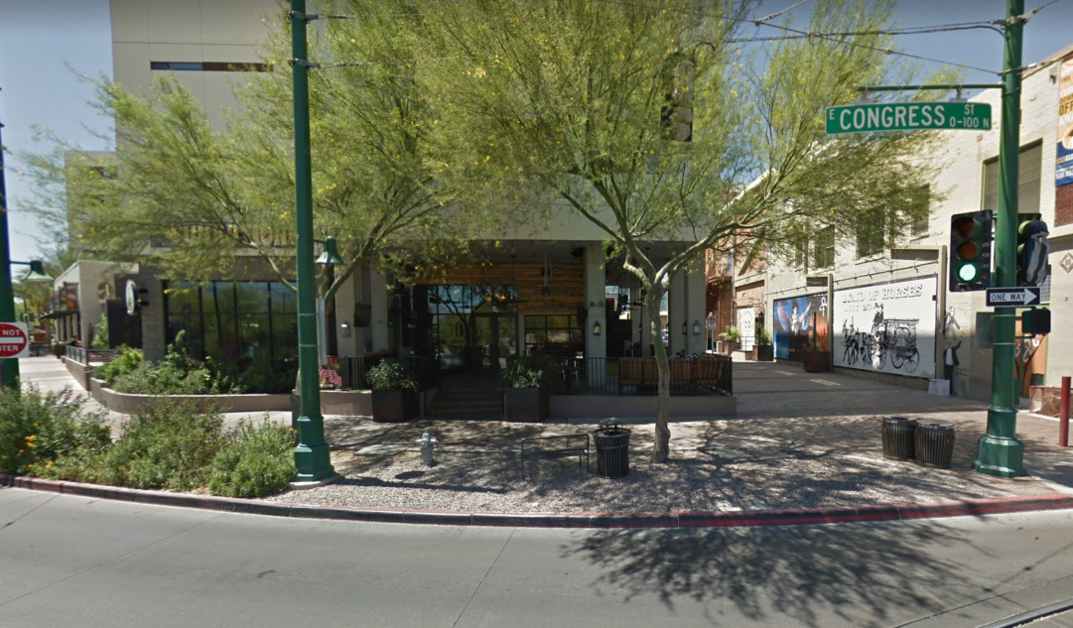
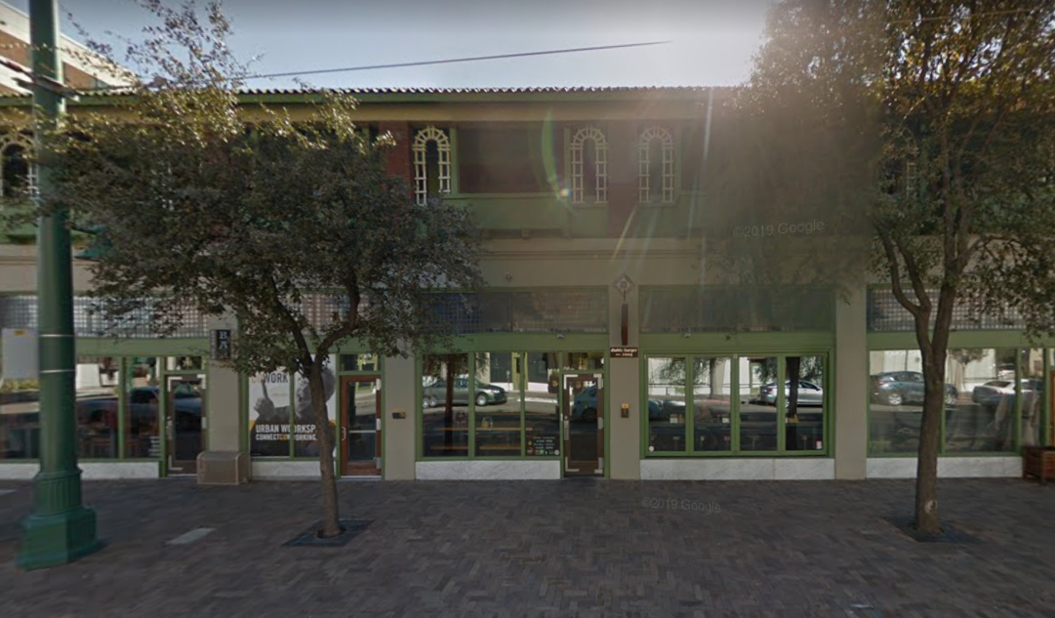
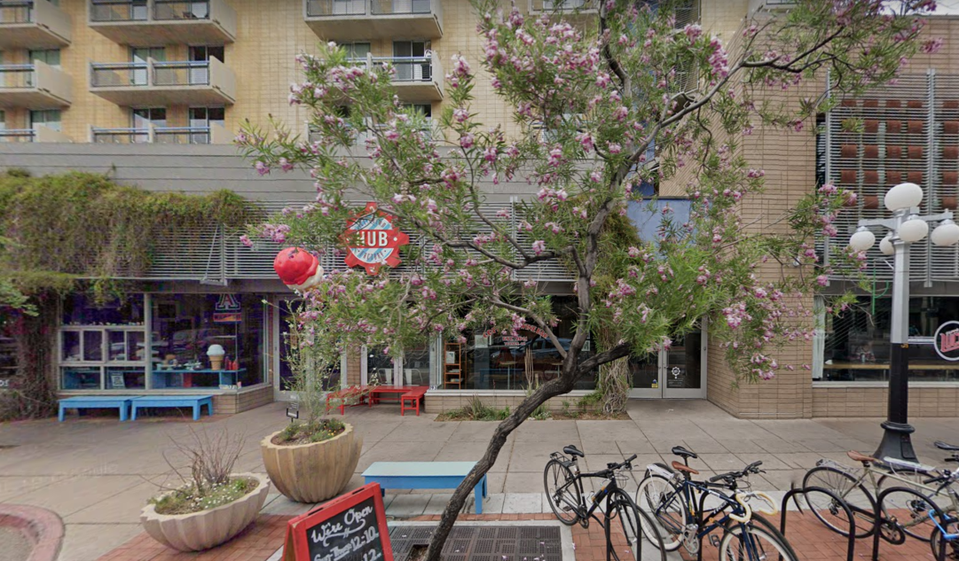
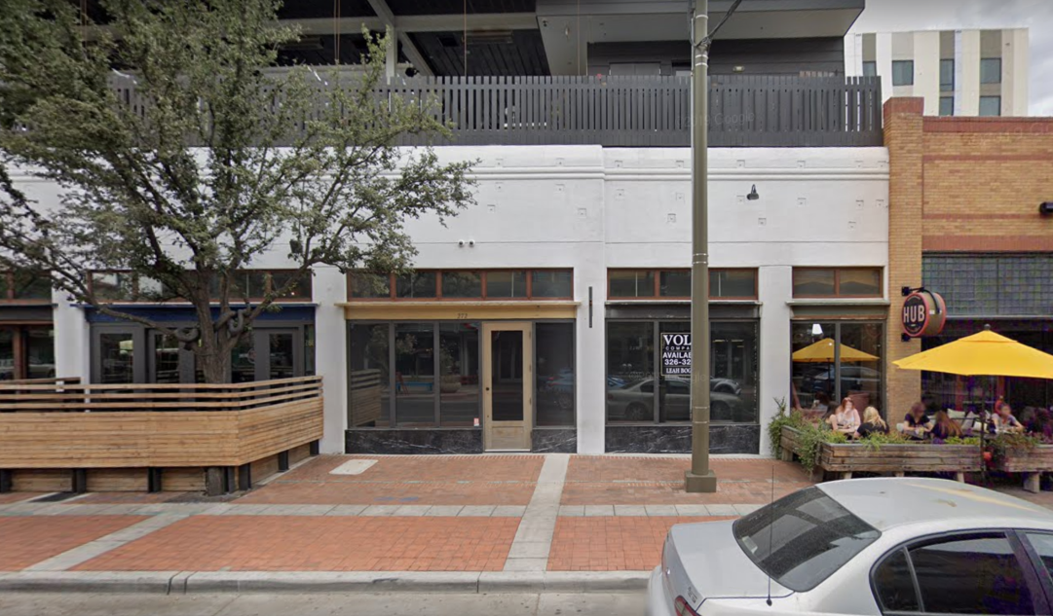
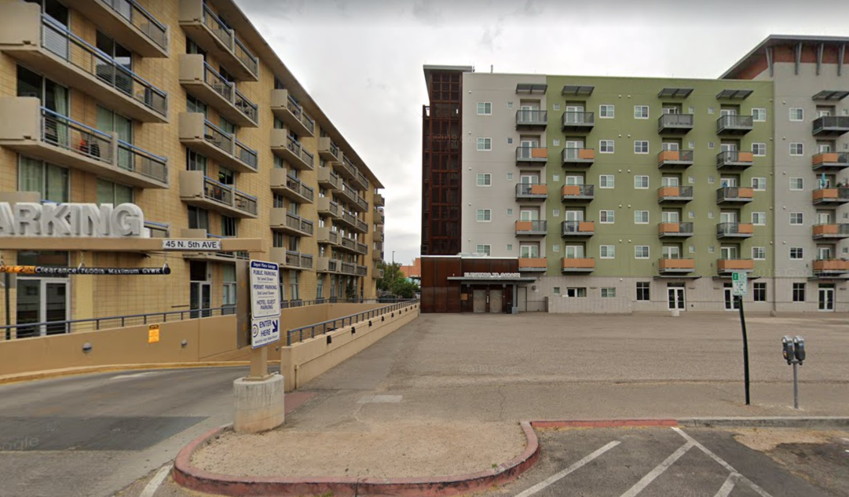
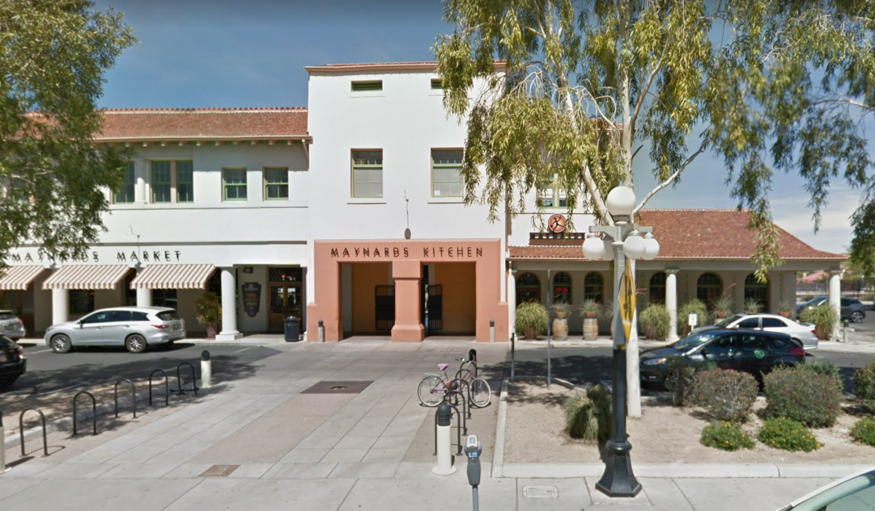
01
02
06
03
04
05
04
SITE
03
02
01
05
06
DEVELOPMENT ZONE

Slide 8
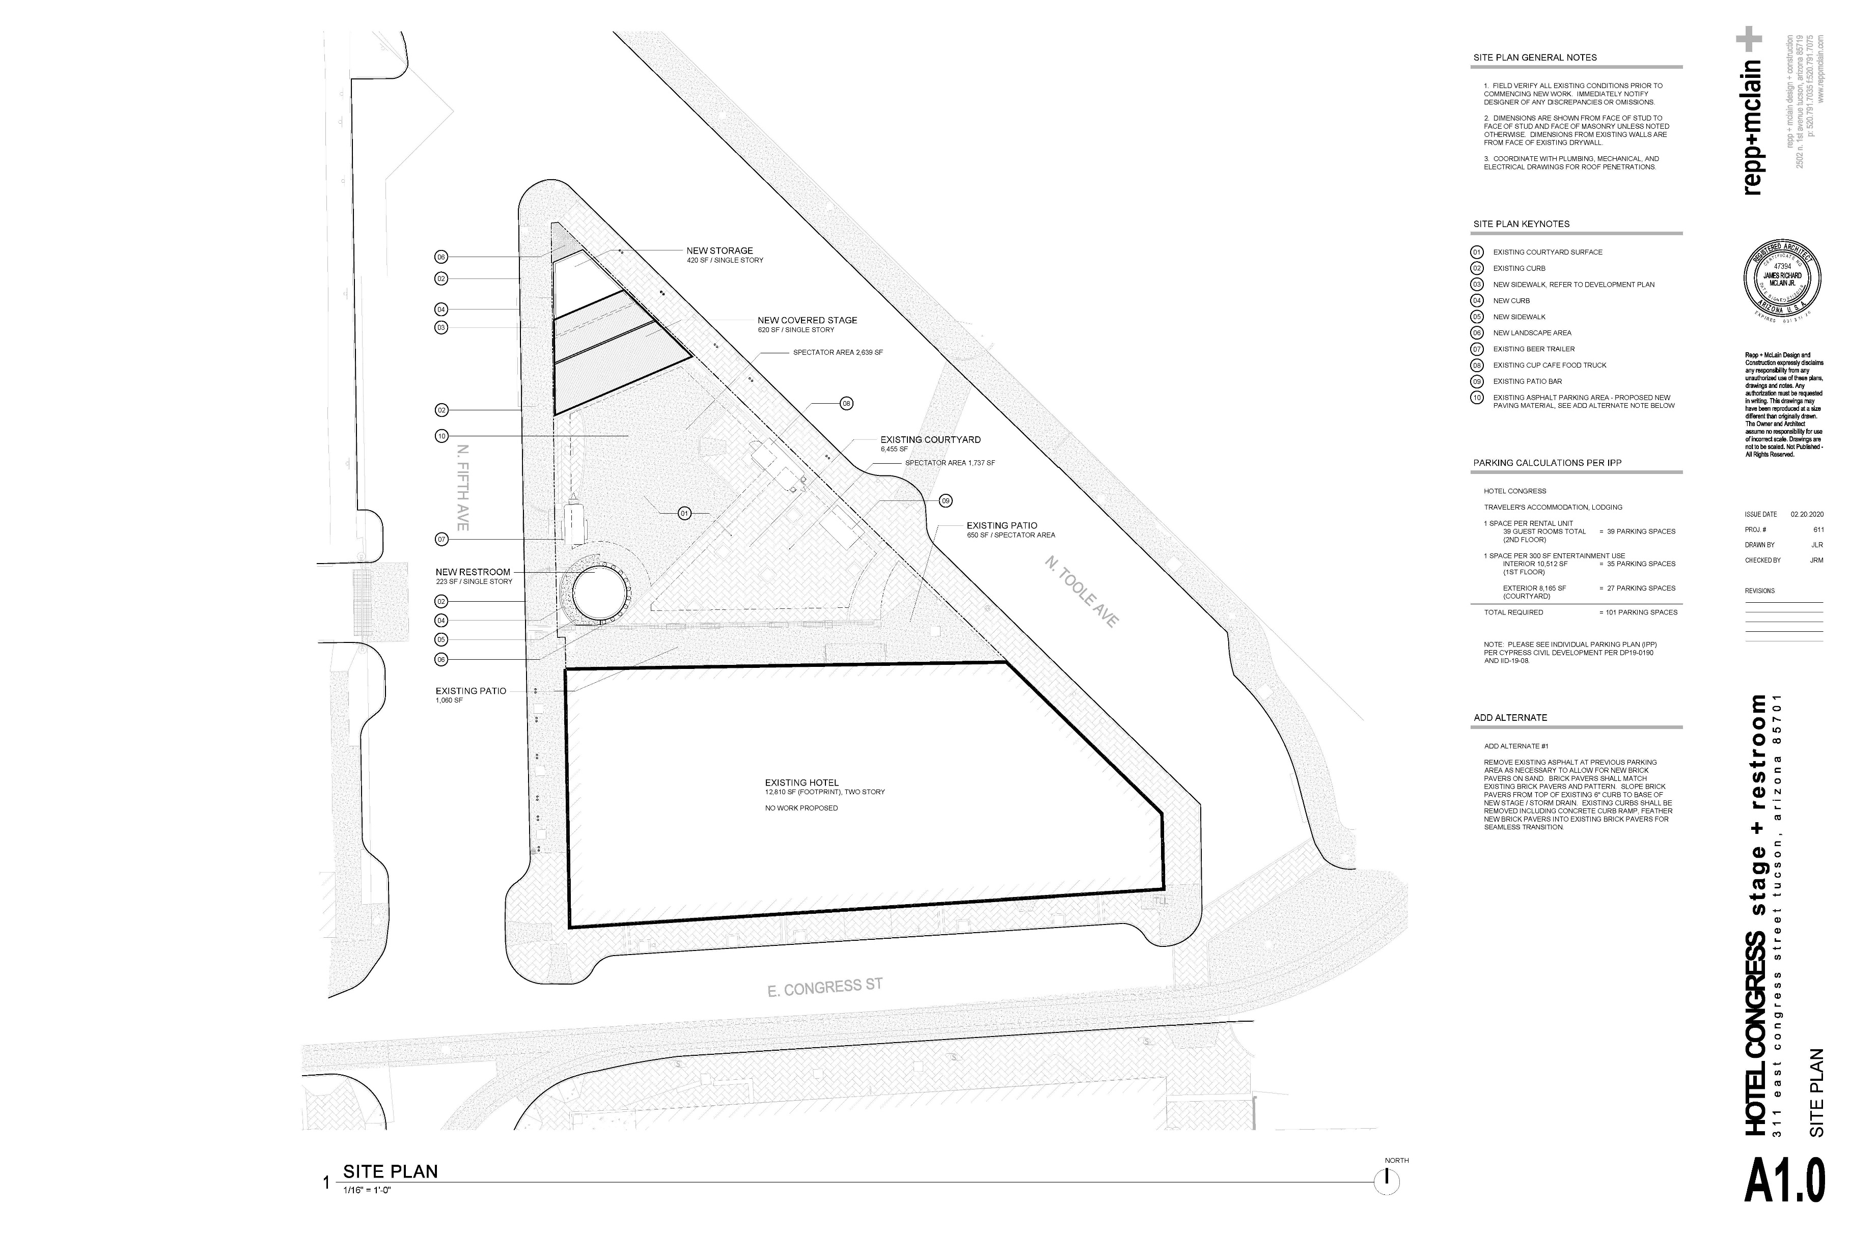

Slide 10
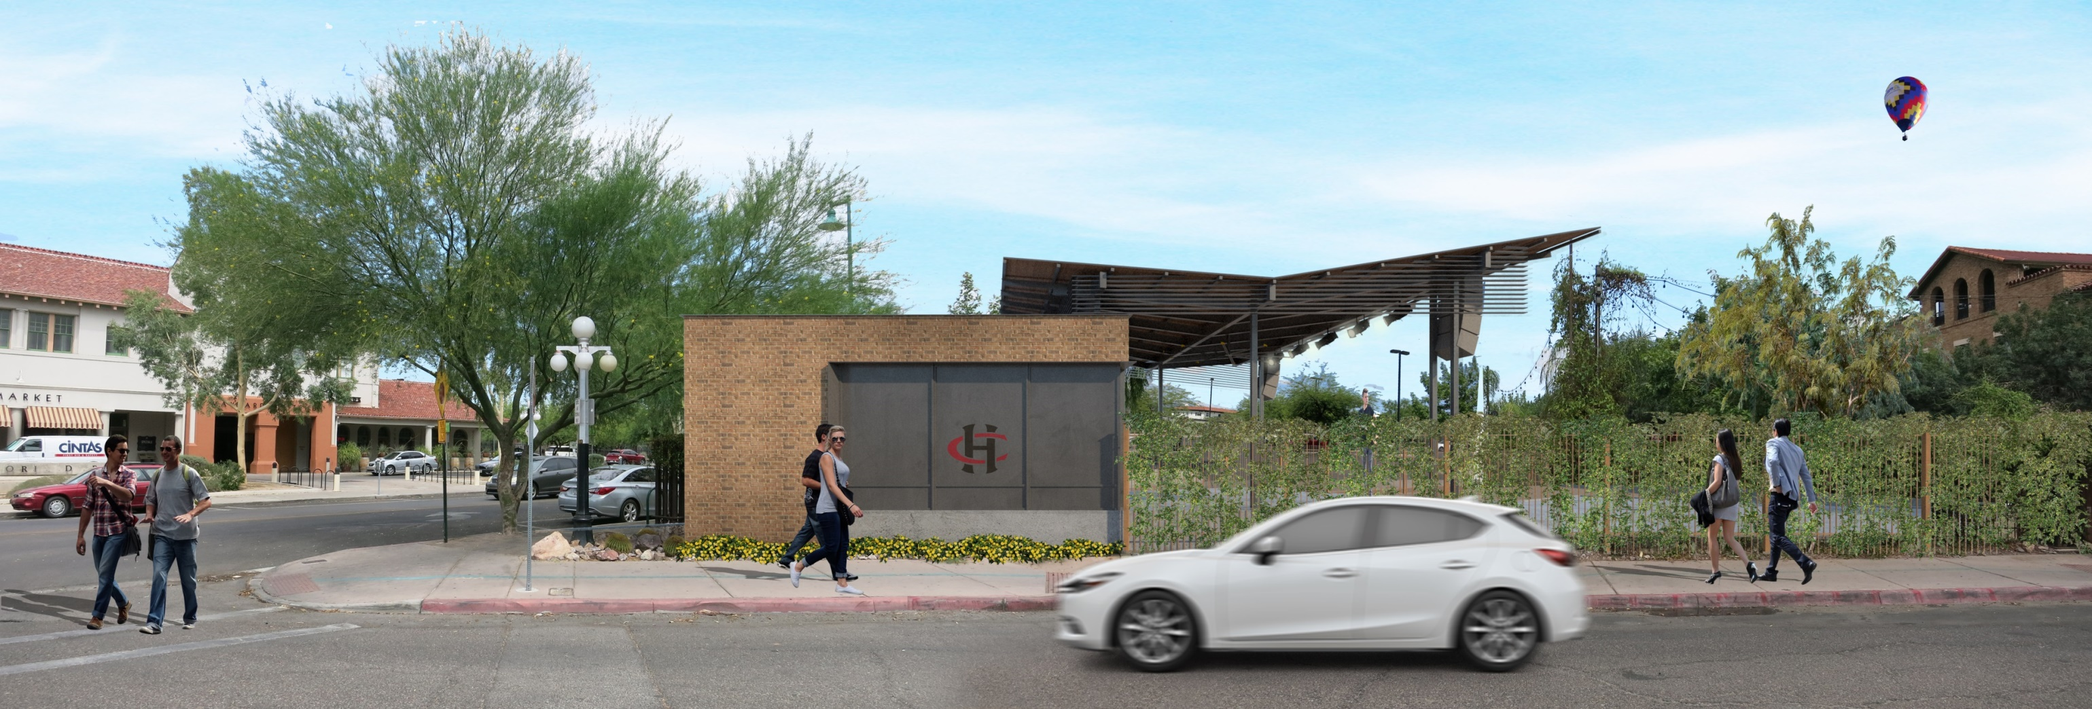

Slide 11
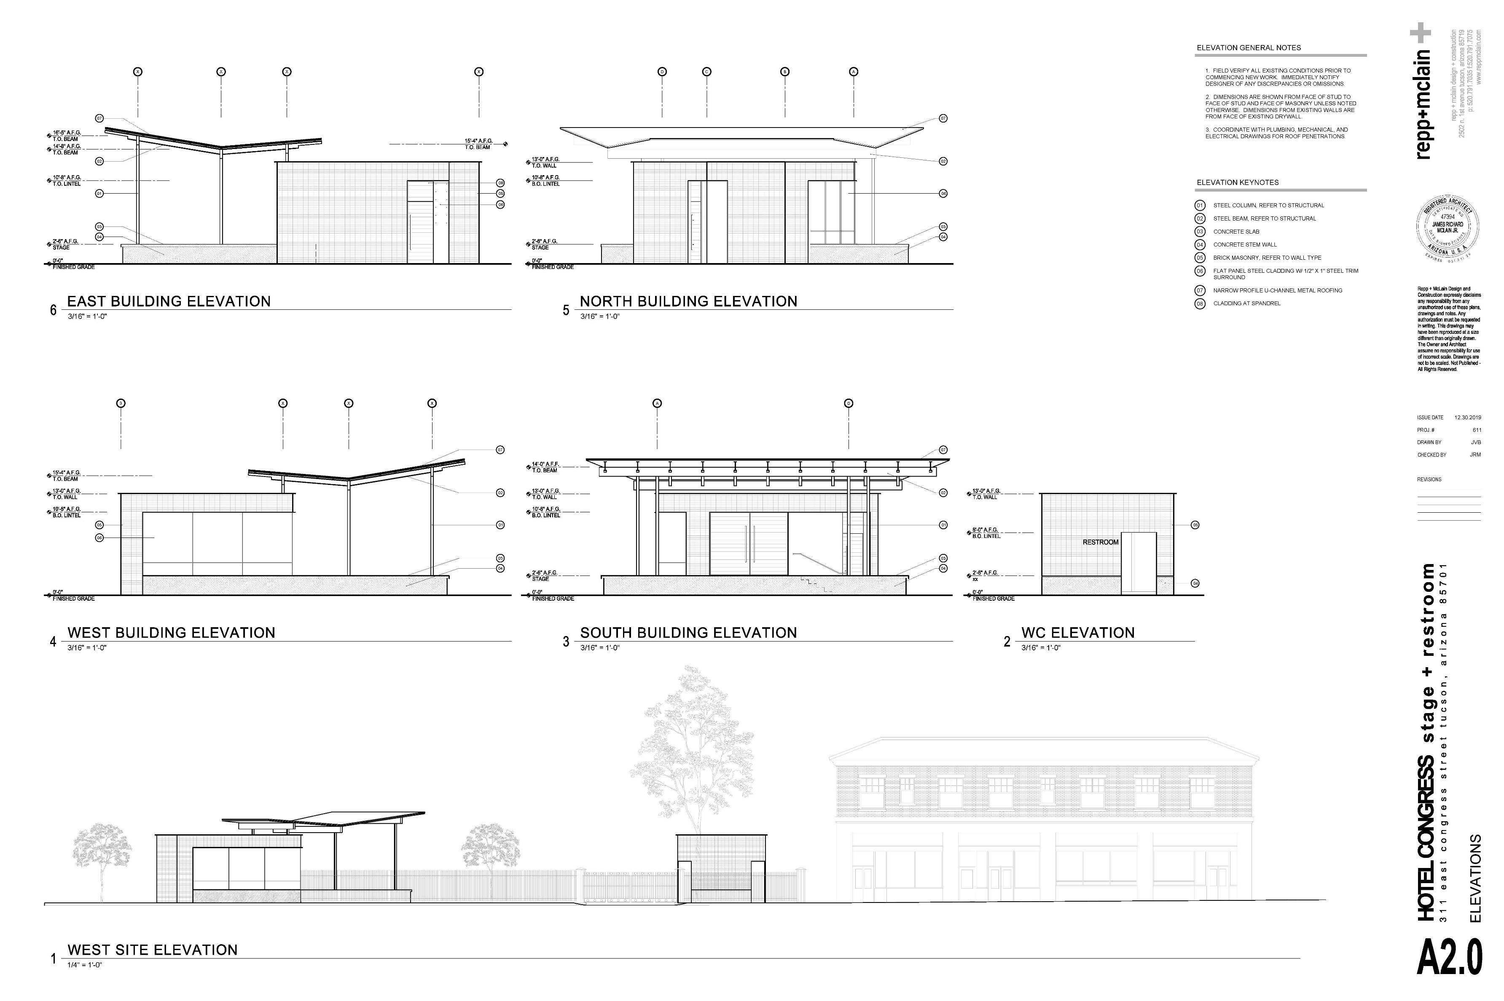

Slide 12
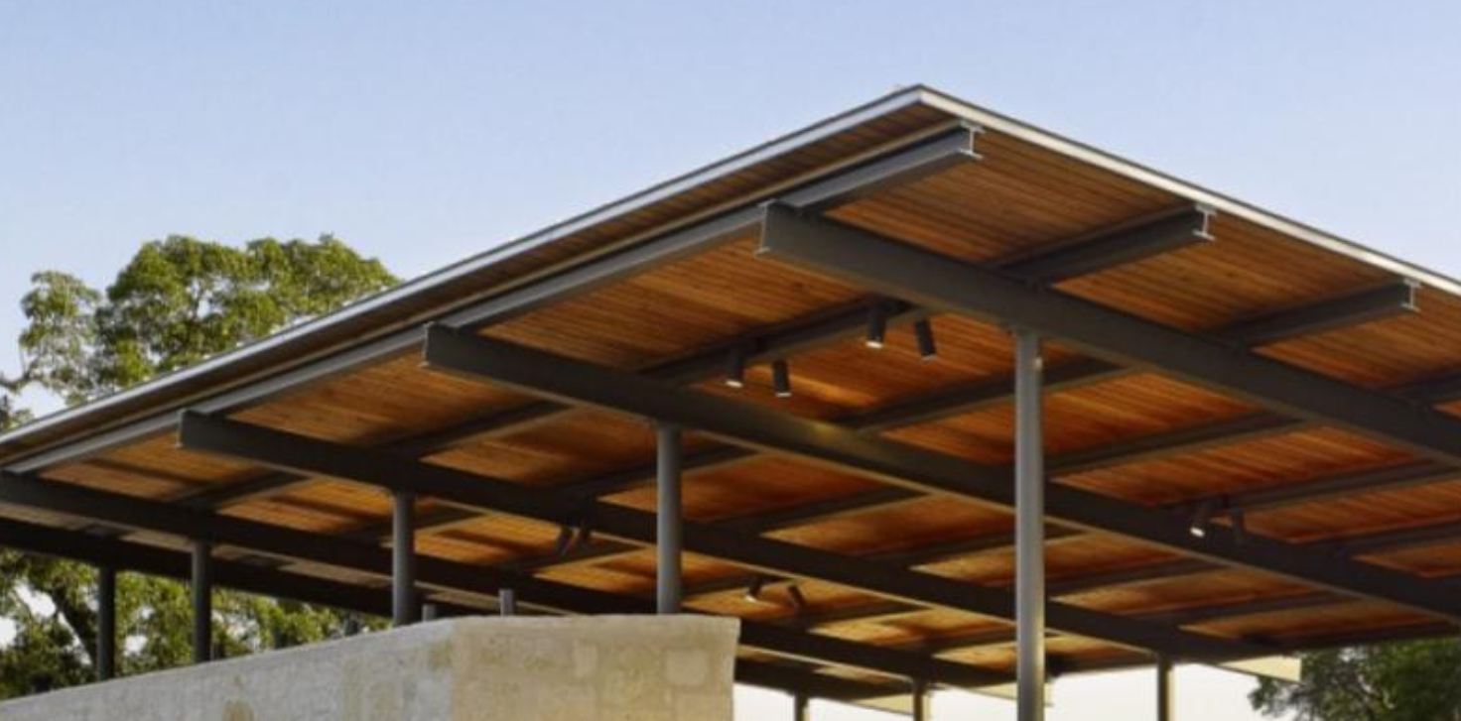
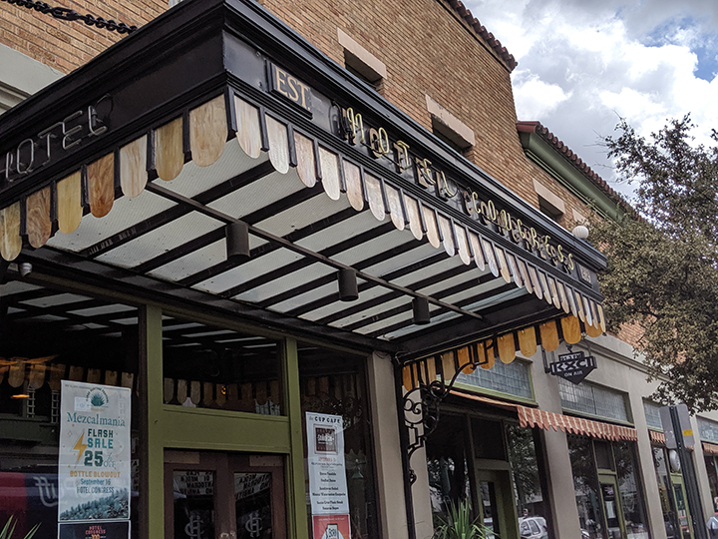
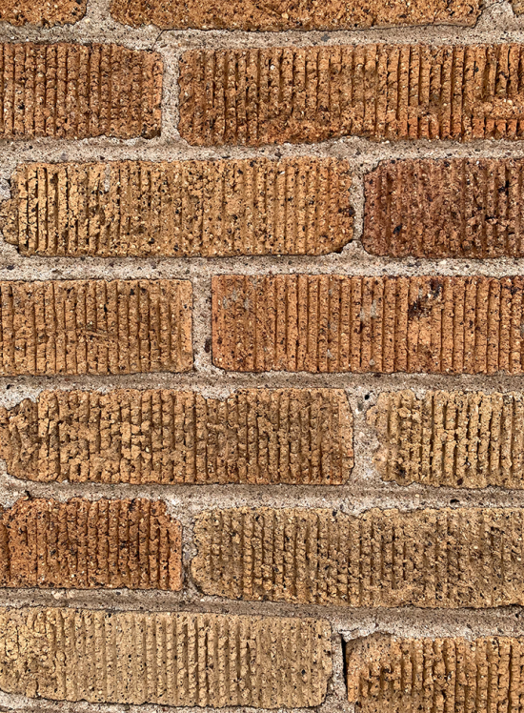
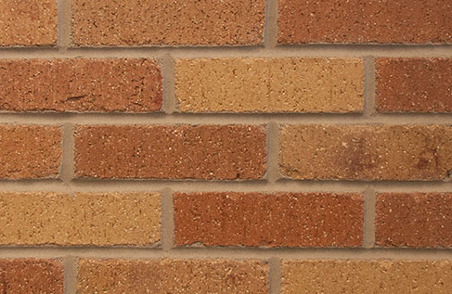
DESIGN CONCEPT - EXAMPLE OF BLACK PAINTED, EXPRESSED STRUCTURAL STEEL W/ LIGHTING
EXISTING HOTEL CONGRESS PORTICO. BLACK PAINTED METAL, EXPRESSED STRUCTURE & LIGHTING
EXISTING HOTEL CONGRESS BRICK
RUNNING BOND
BRICK DIMENSIONS & MATCHING MORTAR JOINTS
STACK BOND AT NEW WORK – DIFFERENTIATED FROM EXISTING HOTEL CONGRESS RUNNING BOND
CUSTOM WIRE FACE BRICK & COLOR FROM SUMMIT BRICK
(WIRE FACE NO SHOWN)
MATERIALS & STRUCTURE

Slide 13
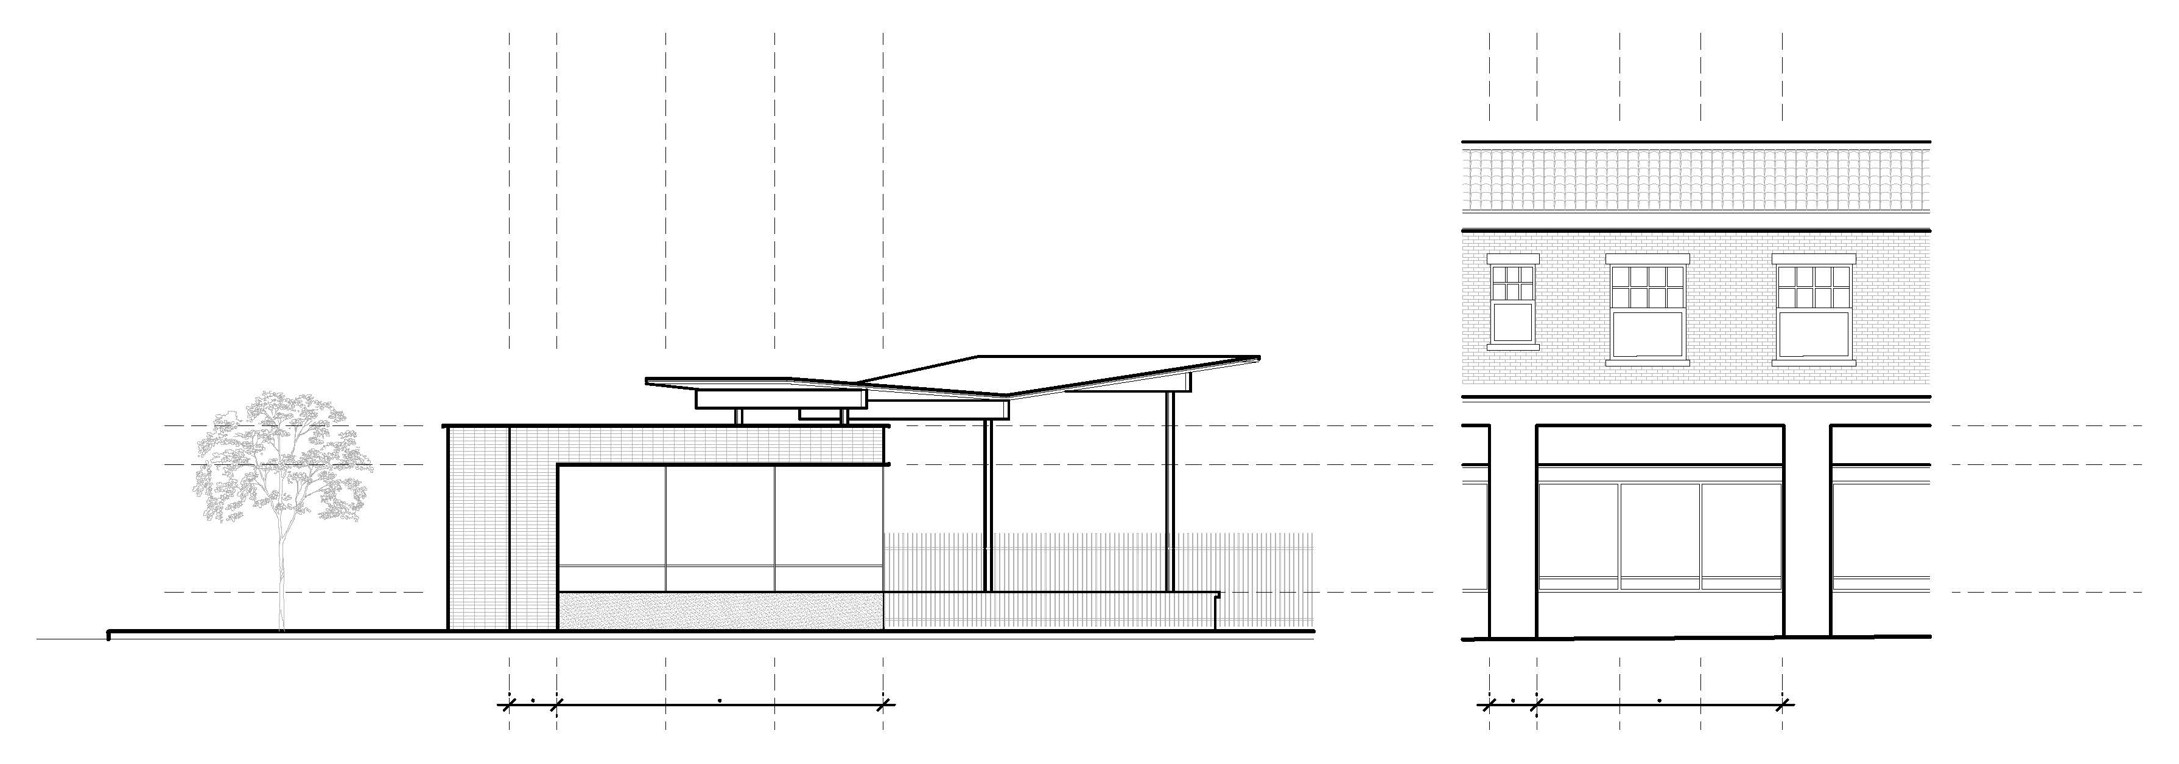
CAP
CAP
HEAD
HEAD
PLINTH
PLINTH
COLUMN
WIDTH
3 EQ. BAYS
COLUMN
WIDTH
3 EQ. BAYS
SCALE, PROPORTION & RHYTHM

Slide 14
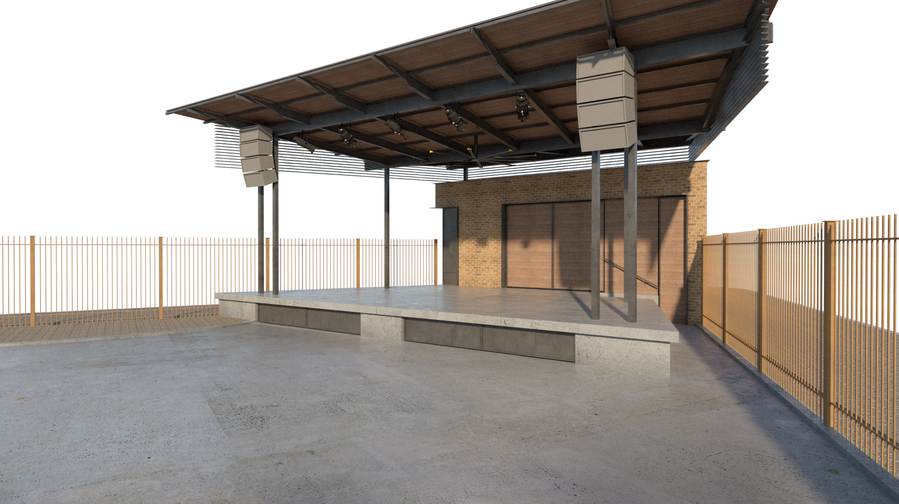
HEAVY AGGREGATE CONCRETE PLATFORM
BLACK PAINTED STEEL STRUCTURE
CUSTOM COLOR WIRE FACE BRICK
WOOD CEILING

Slide 15
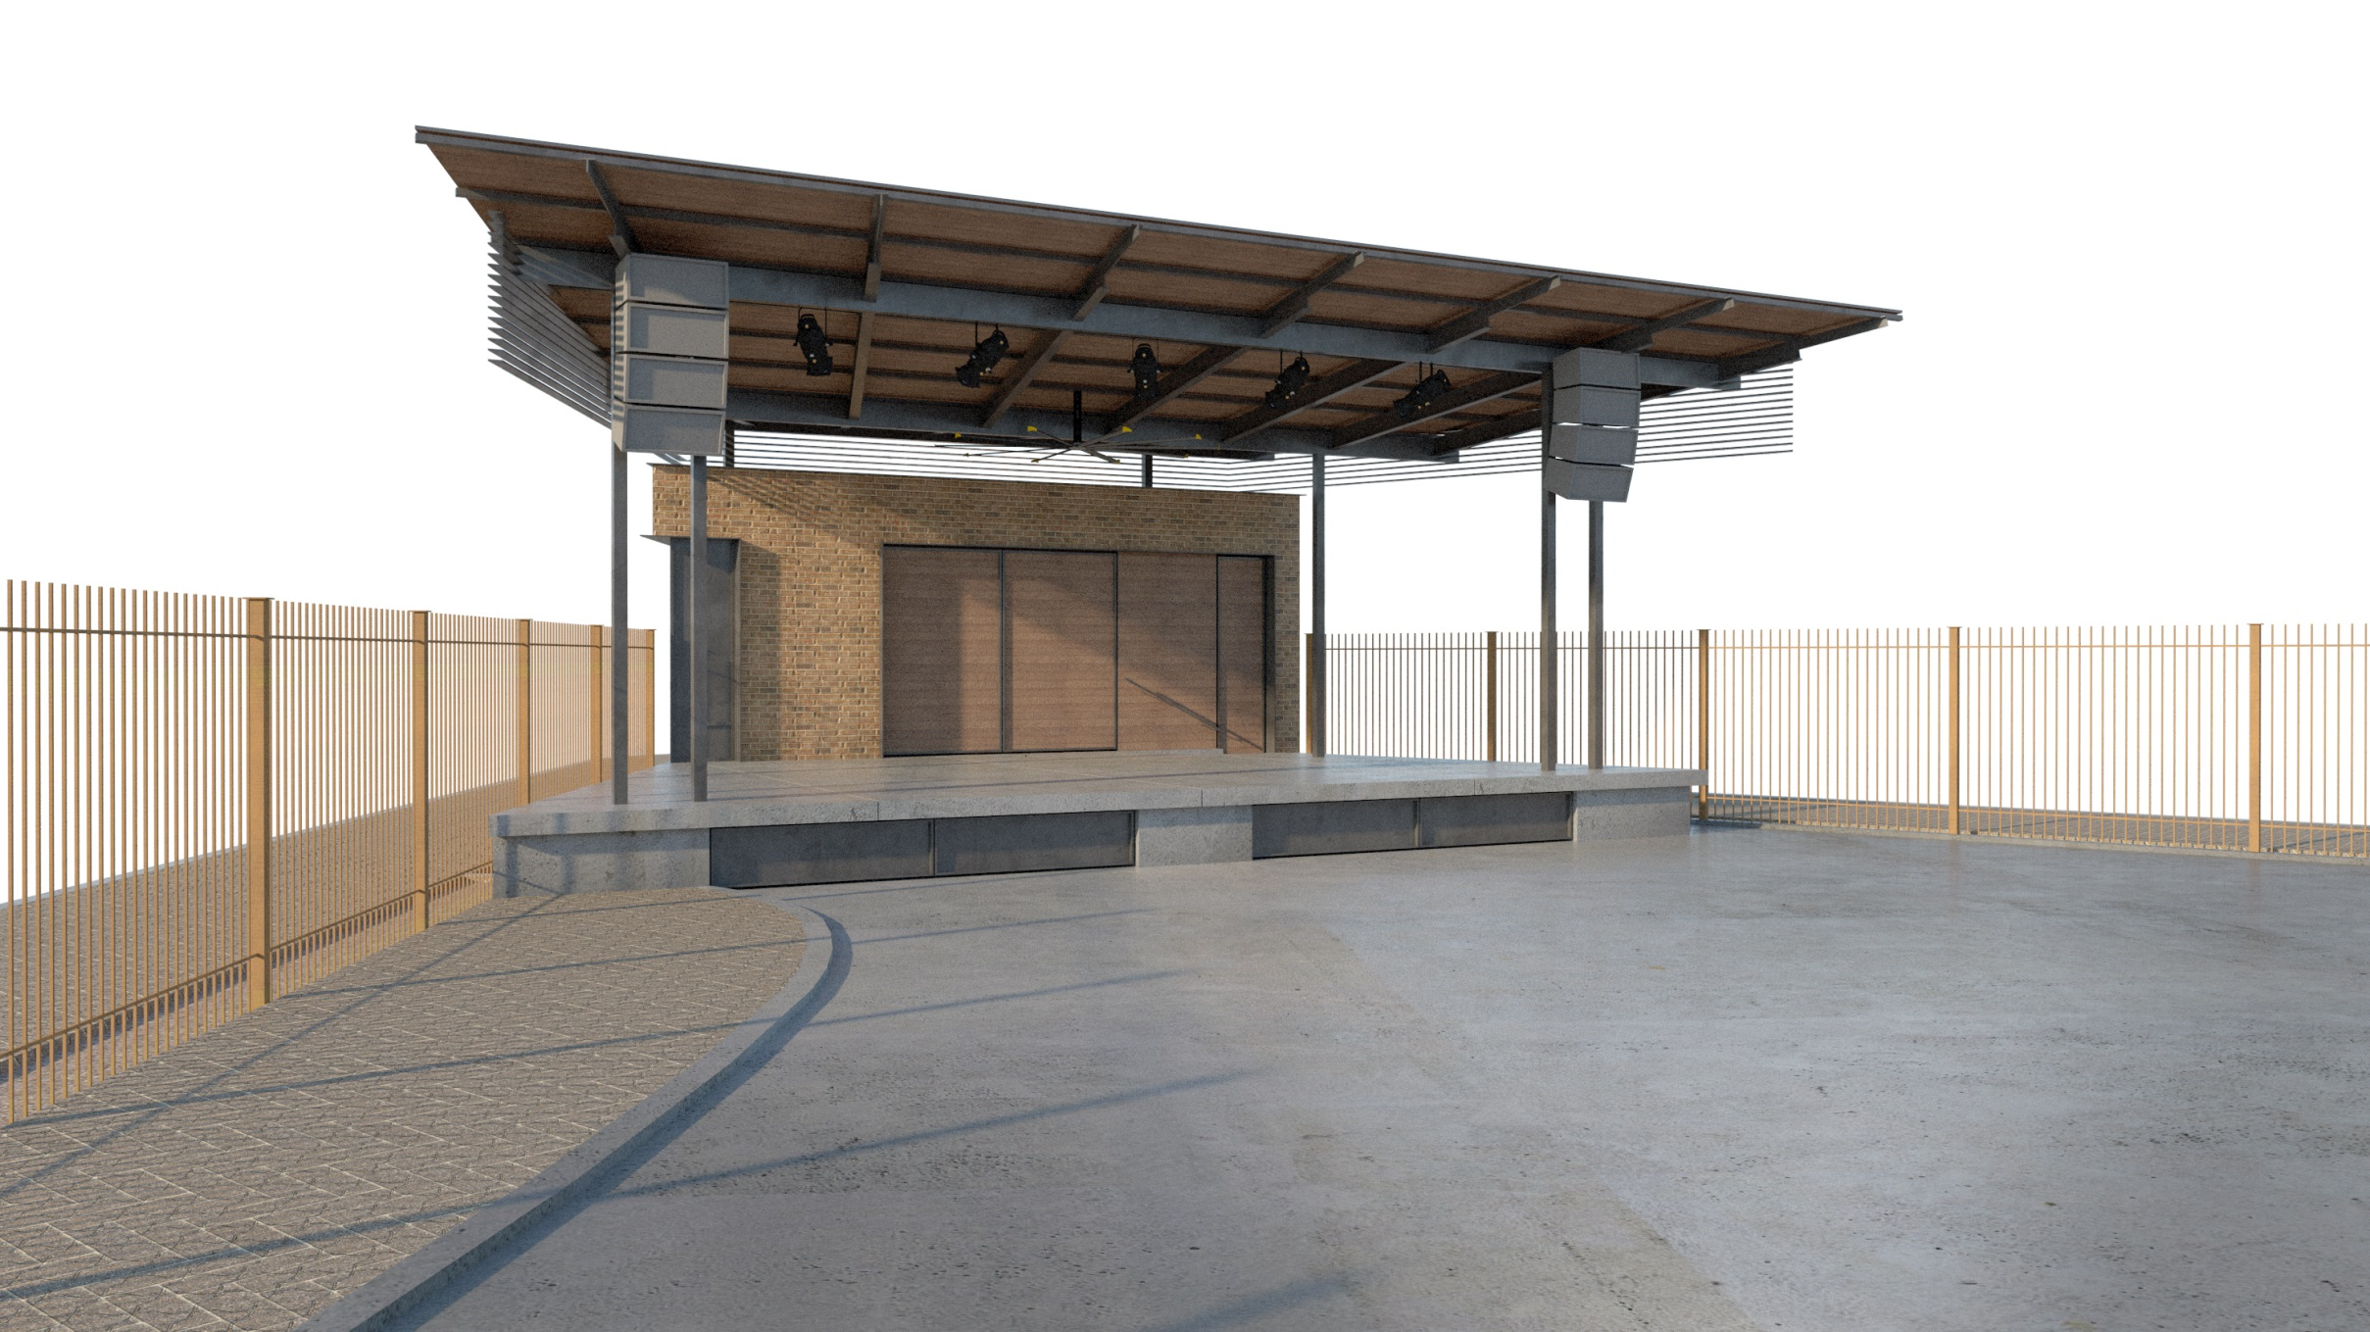
BLACK PAINTED STEEL STRUCTURE
CUSTOM COLOR WIRE FACE BRICK
WOOD CEILING

Slide 16
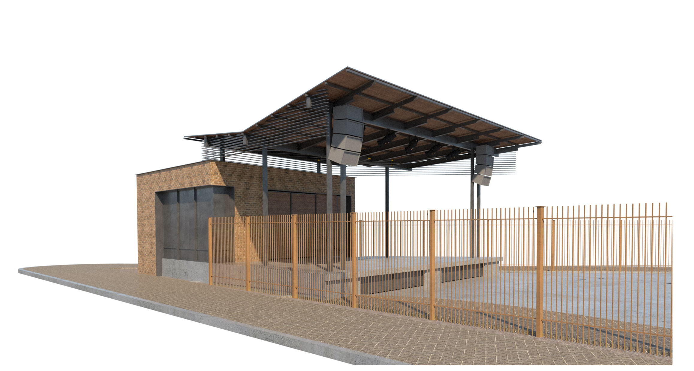
FLAT PANEL PANTED STEEL WITH 1” TRIM
BLACK PAINTED STEEL STRUCTURE
WOOD CEILING

Slide 17
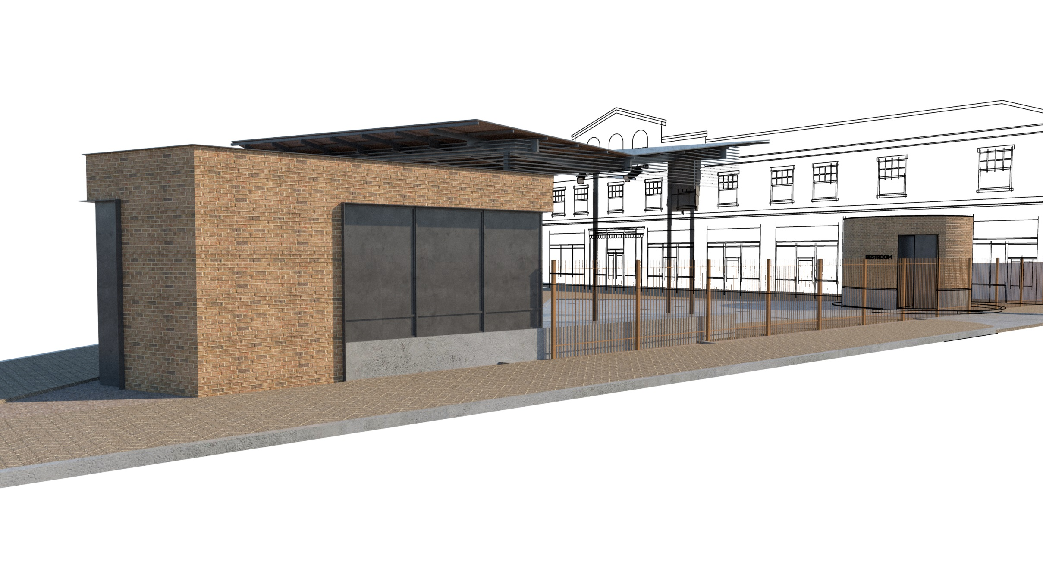
CUSTOM COLOR WIRE FACE BRICK
FLAT PANEL PANTED STEEL WITH 1” TRIM
HEAVY AGGREGATE CONCRETE PLATFORM
BLACK PAINTED STEEL STRUCTURE
CUSTOM COLOR WIRE FACE BRICK
HEAVY AGGREGATE CONCRETE PLATFORM

Slide 18
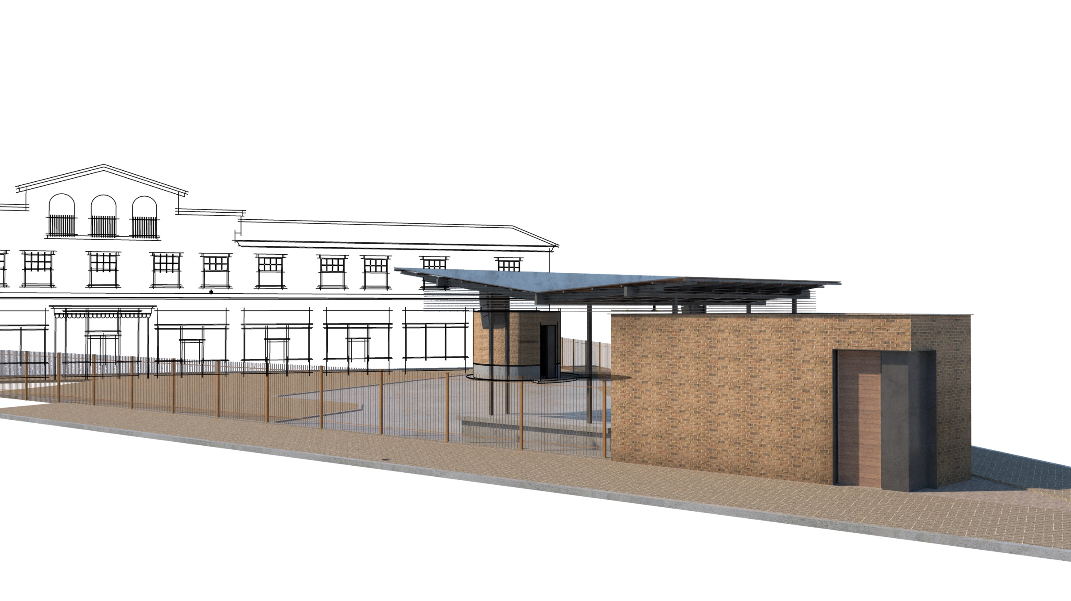
BLACK PAINTED STEEL STRUCTURE
CUSTOM COLOR WIRE FACE BRICK
BLACK PAINTED STEEL STRUCTURE

Slide 19
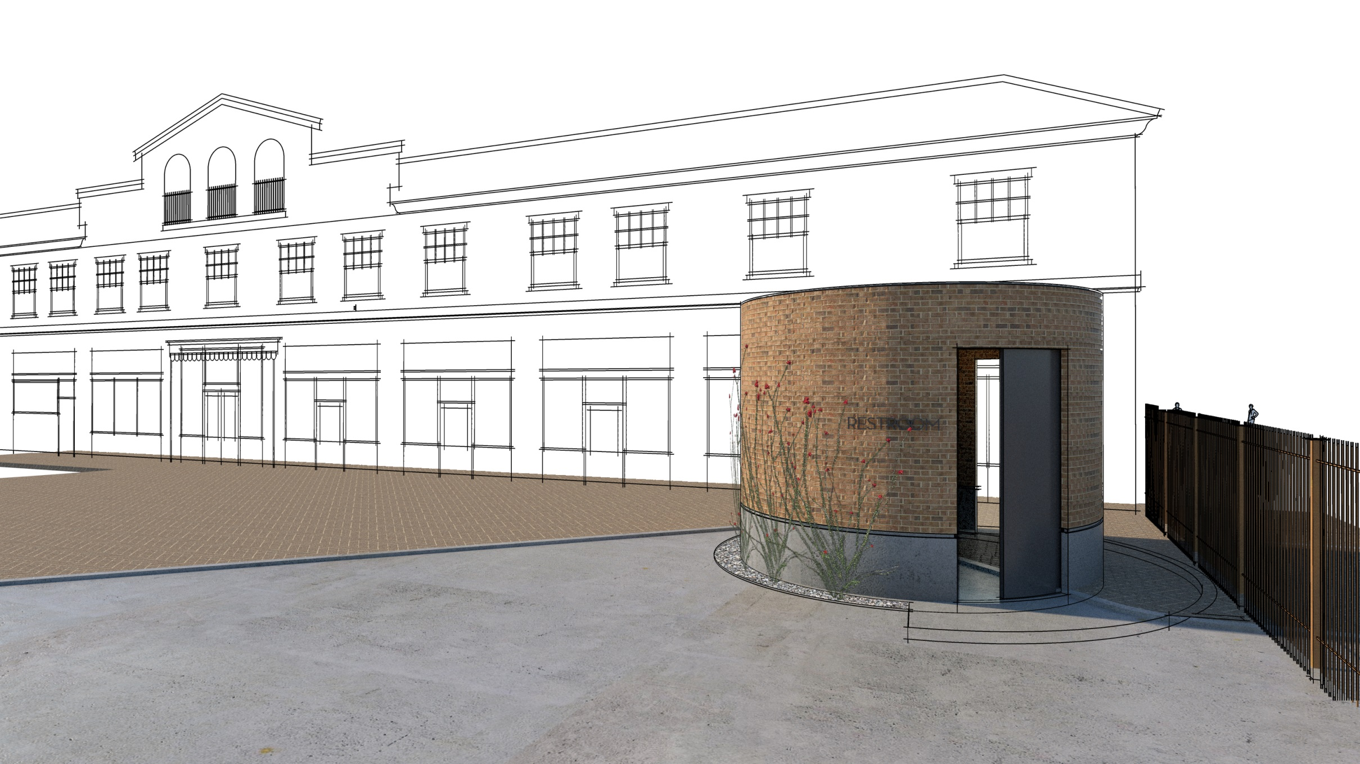
HEAVY AGGREGATE CONCRETE PLATFORM
CUSTOM COLOR WIRE FACE BRICK

Slide 20
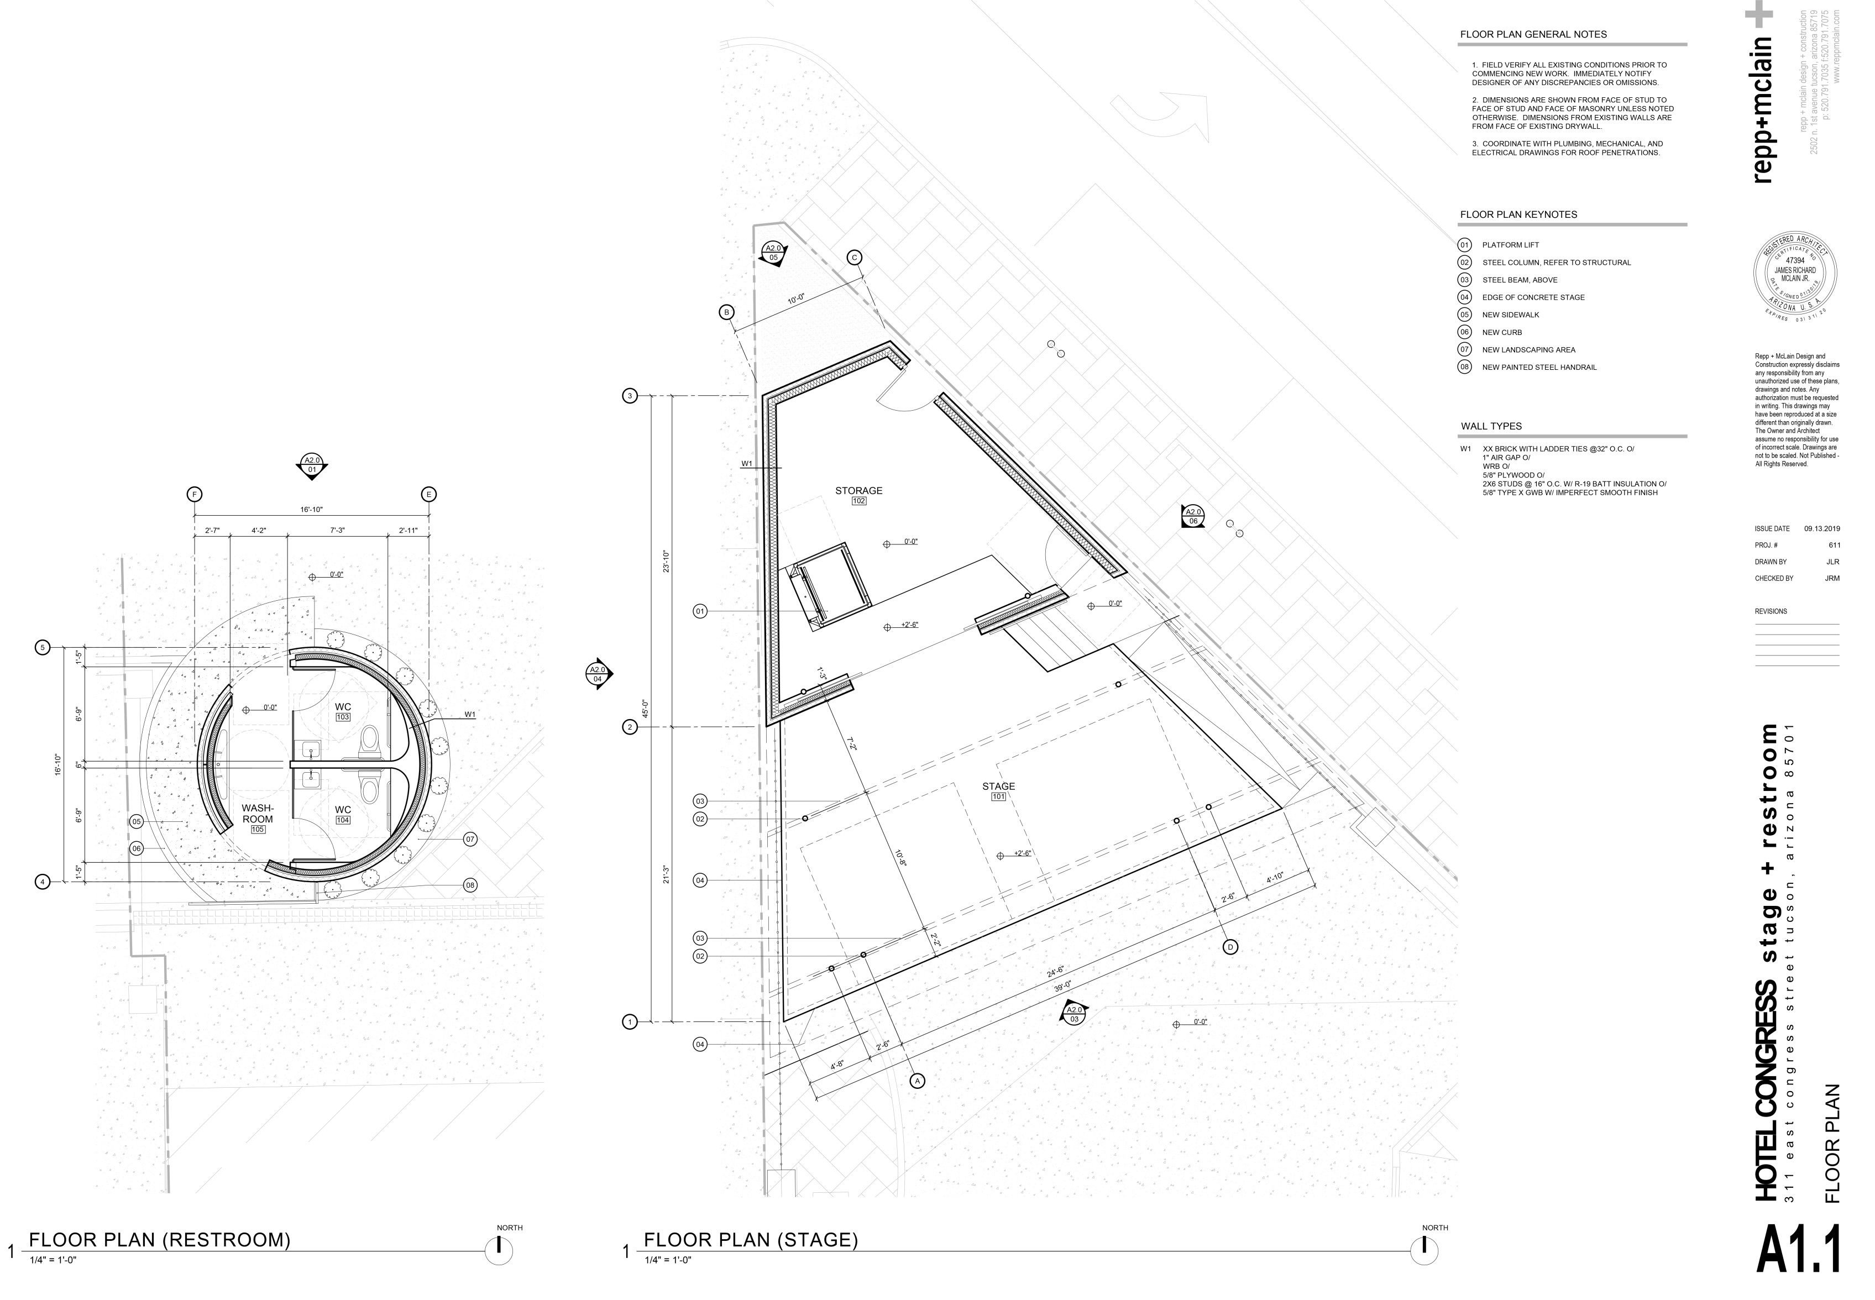

Slide 21
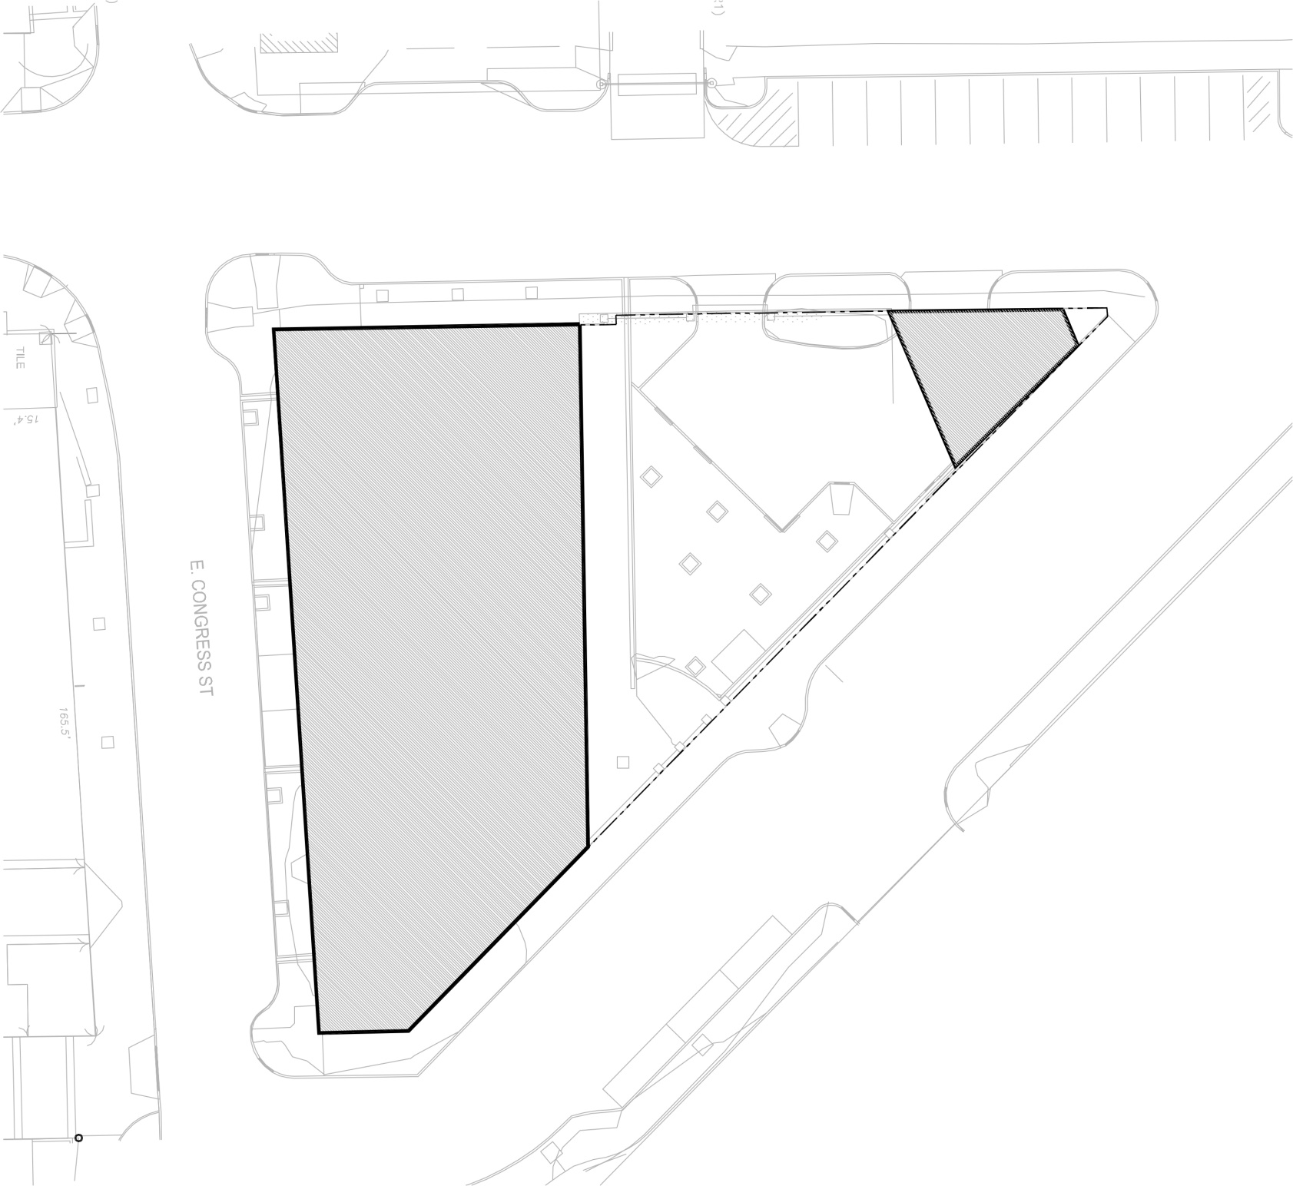
PROPOSED
STAGE
EXISTING HOTEL
PROPERTY LINE
SITE UTILIZATION

Slide 22
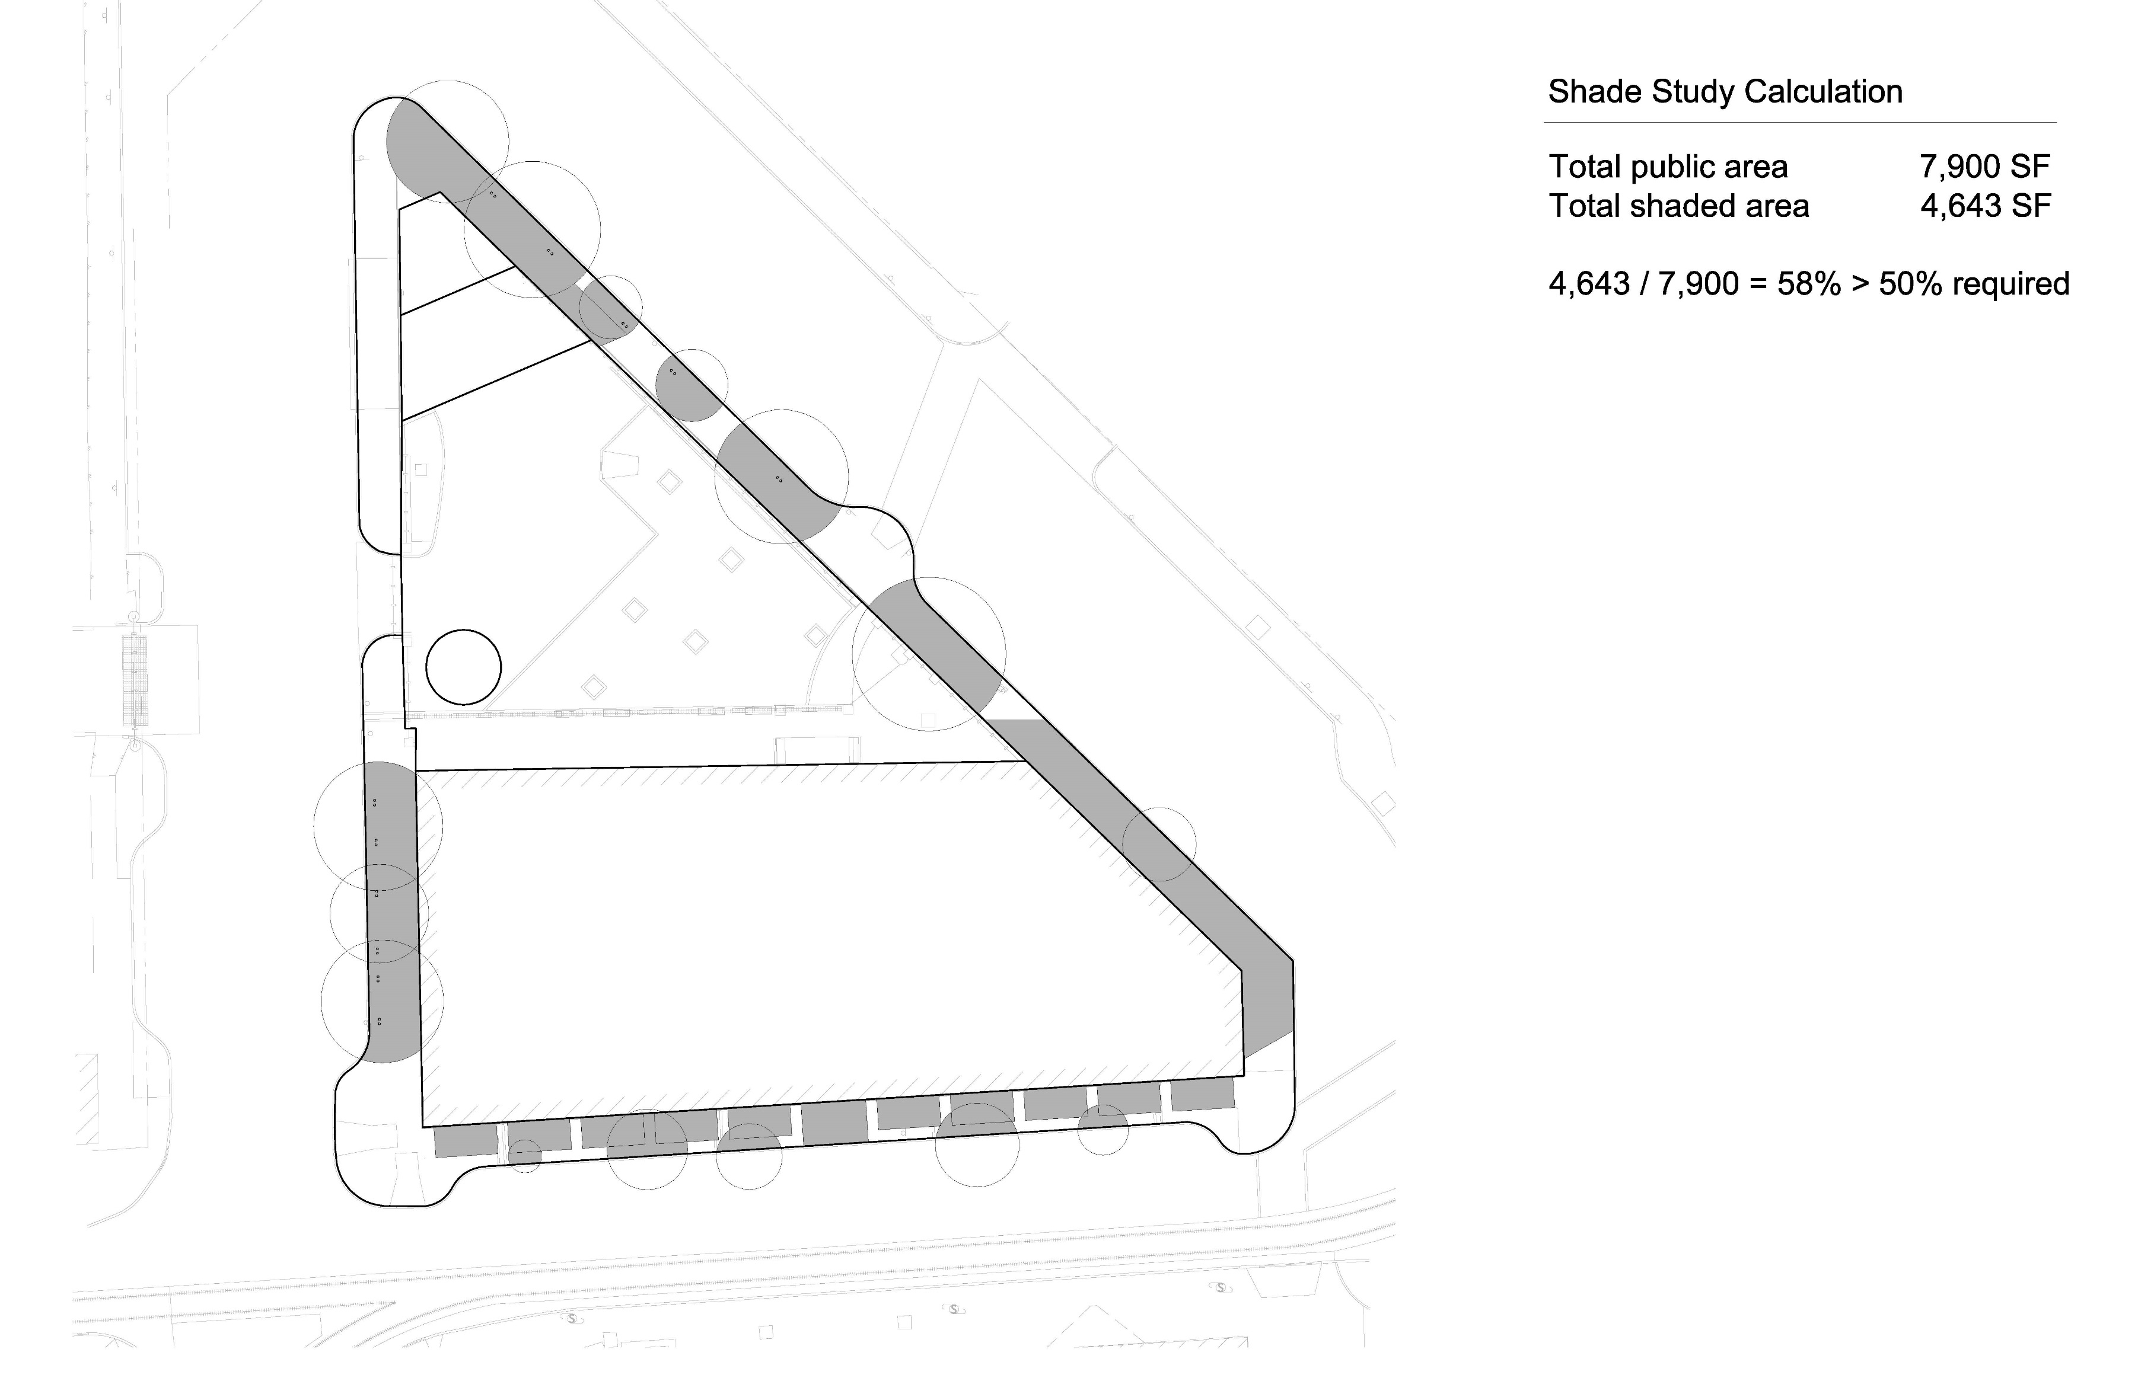

Slide 23
