Slide 1
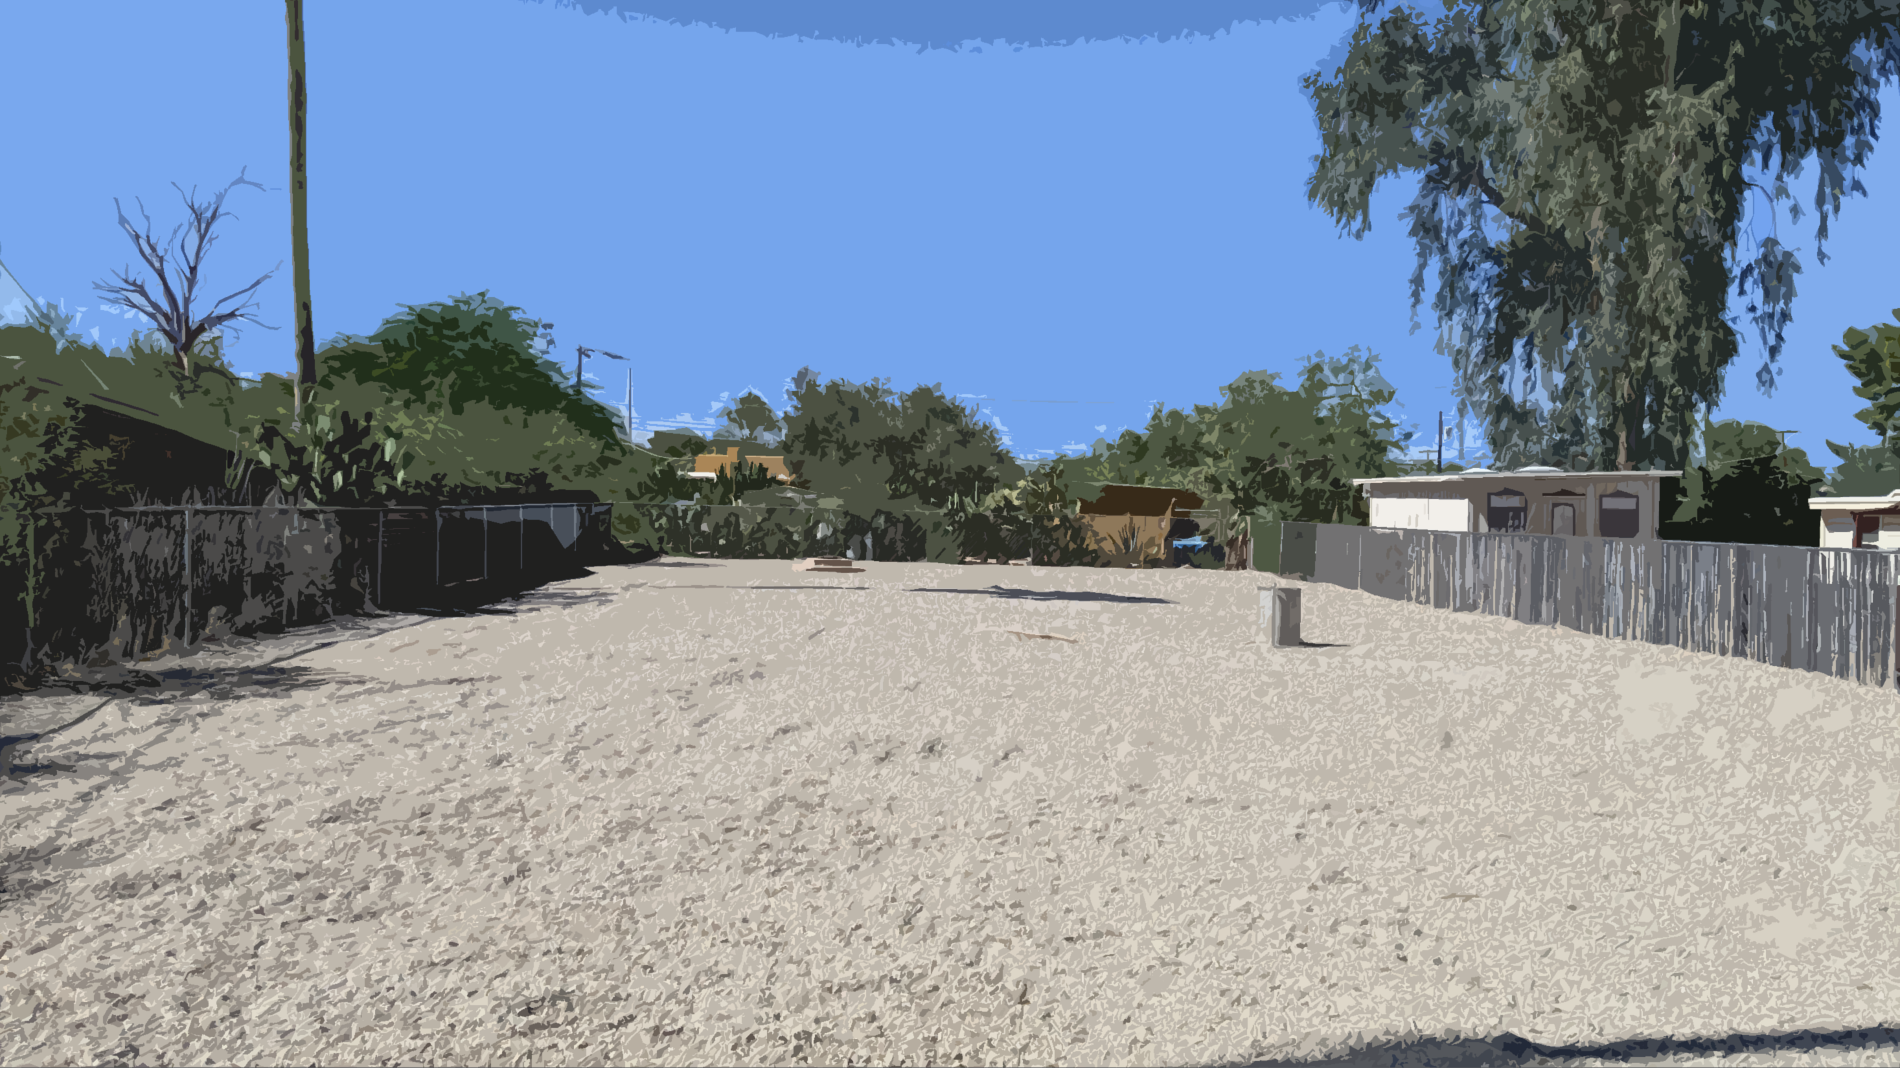
WELL B-052B SITE IMPROVEMENTS 1937 North Nancy Rose Boulevard
Design Review Board
March 12, 2021

Slide 2
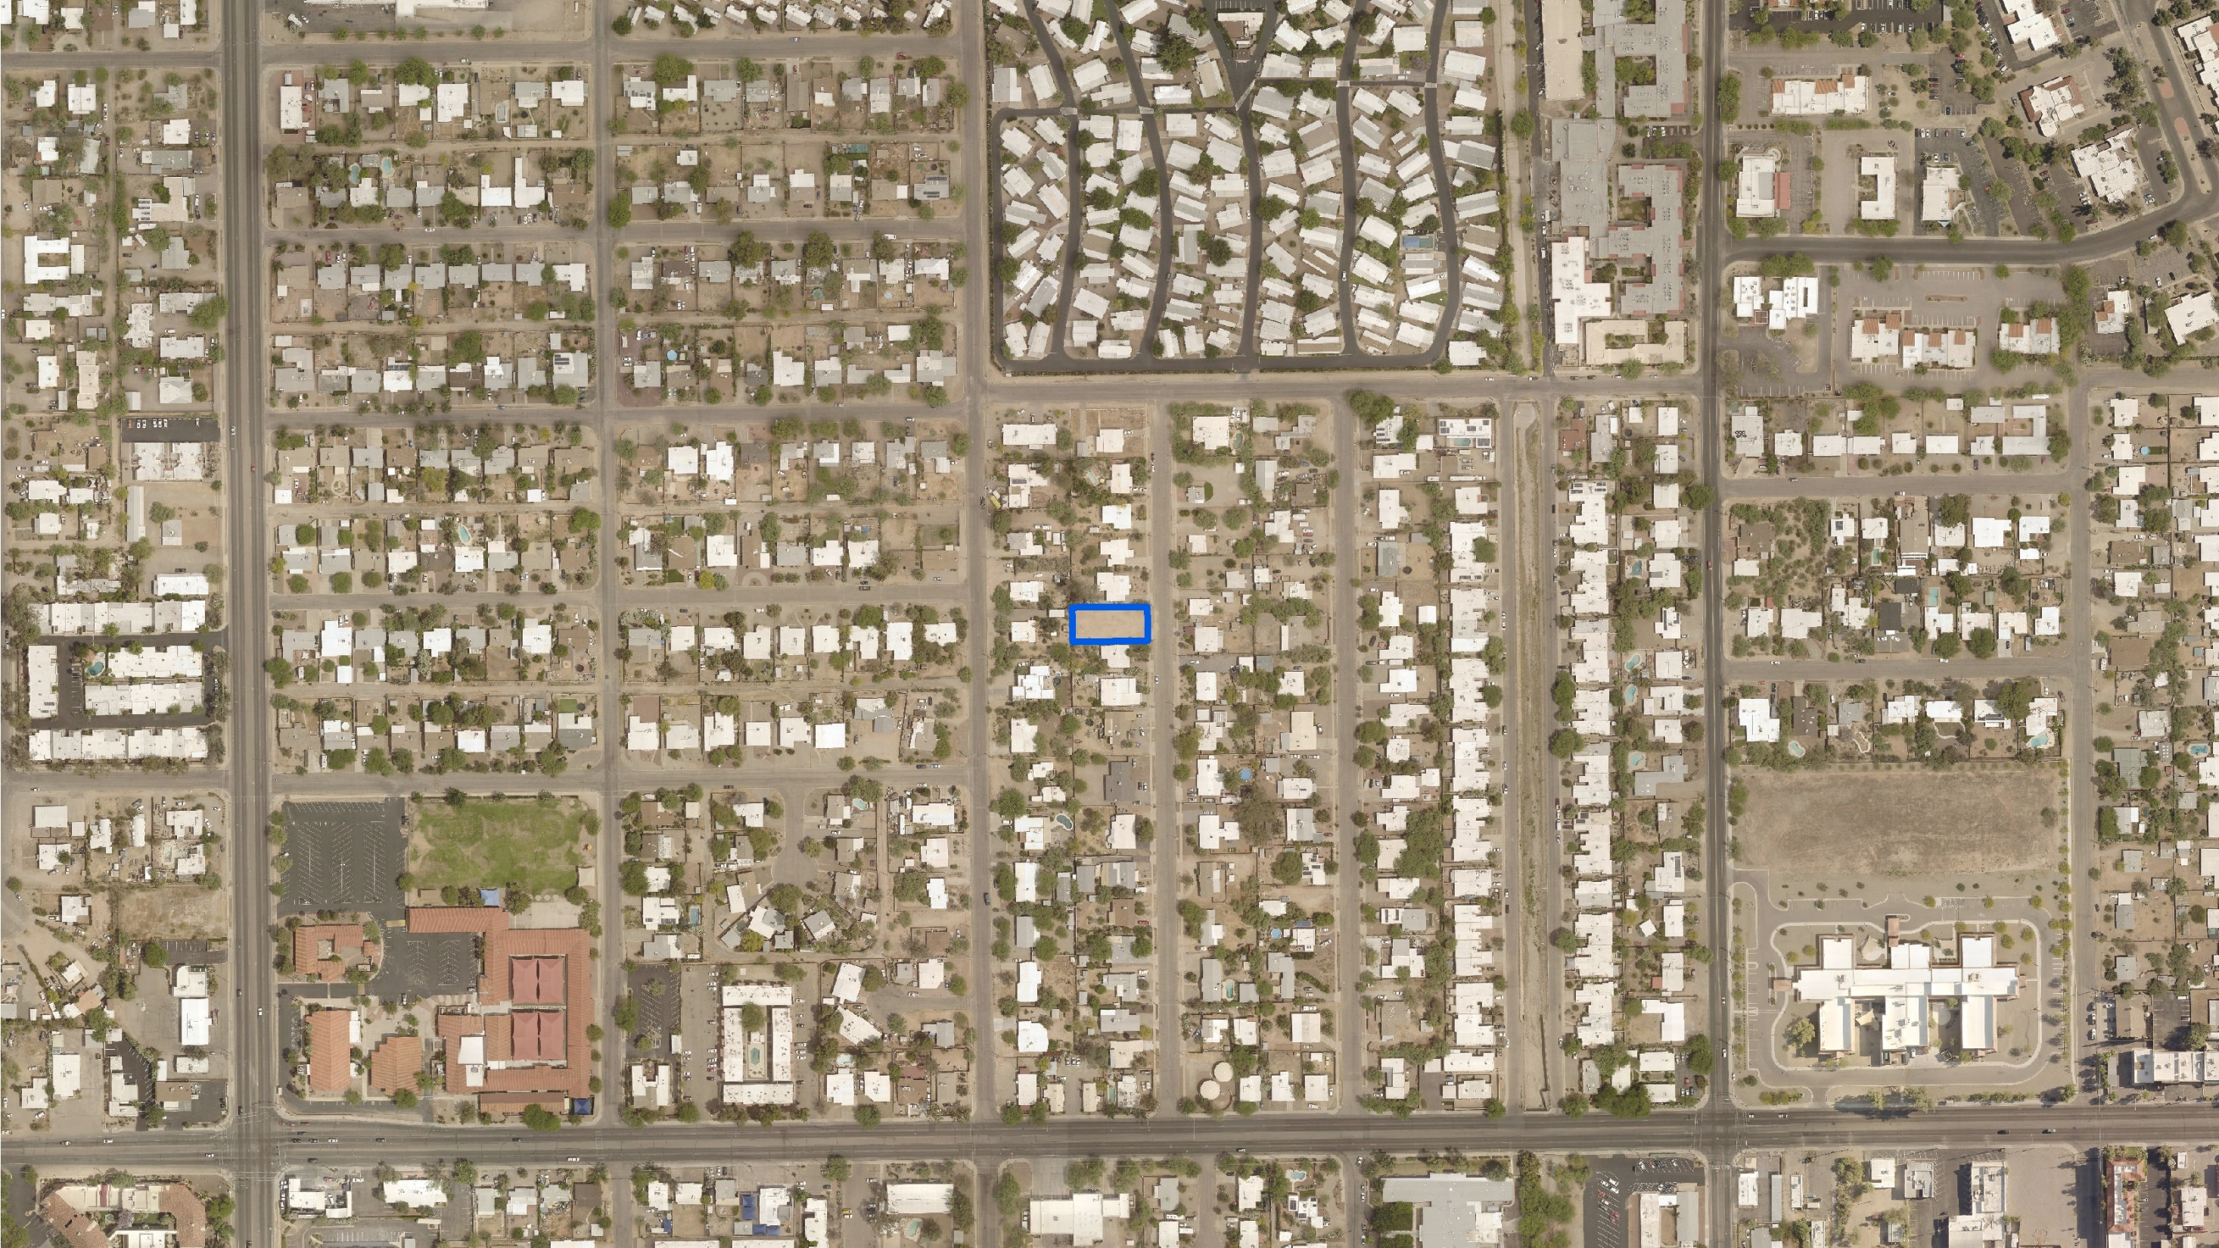
CONTEXT MAP
EDISON STREET
FAR HORIZONS
CO-OP ESTATES
HAMPTON STREET
FARNESS STREET
SENECA STREET
SENECA STREET
SUBJECT PROPERTY
PEACH STREET
SWAN ROAD
WAVERLY STREET
CITRUS STREET
MOUNTAIN VIEW AVENUE
ARCADIA AVENUE
SANTA ROSA AVENUE
ROSEMONT BOULEVARD
MAGNOLIA AVENUE
LINDEN STREET
NANCY ROSE BOULEVARD
FRANCES BOULEVARD
ST. CYRIL OF ALEXANDRIA ROMAN CATHOLIC PARISH
MOUNTAIN
TERRACE APARTMENTS
PIMA STREET
LEGEND
Well B-052C Property (0.19 AC)

Slide 3
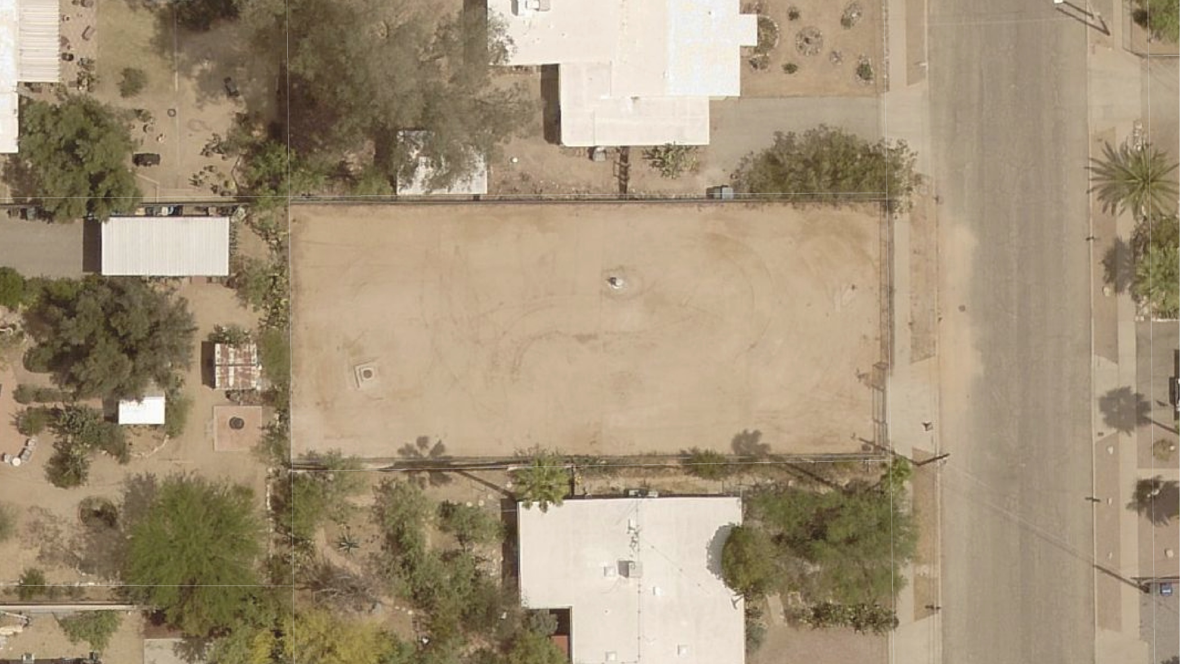
CURRENT CONDITIONS
EXISTING 5-FOOT
CHAIN-LINK FENCE
EXISTING 5-FOOT
CHAIN-LINK FENCE
ORIGINAL WELL
B-052A
(DRILLED IN 1953 AND DEEPENED IN 1975)
WELL B-052B (DRILLED 2019)
EXISTING 5-FOOT
CHAIN-LINK FENCE
EXISTING DRIVEWAY
WITH VEHICULAR GATE
INTERIOR YARD FINSIHED WITH GRAVEL
EXISTING 5-FOOT
CHAIN-LINK FENCE
NANCY ROSE BOULEVARD

Slide 4
PROPOSED SITE PLAN
5,000 GALLON
HYDRO TANK WITH AIR COMPRESSOR
NEW 7’ CHAIIN-LINK FENCE
TEP UTILITY EASEMENT
2 PARKING
SPACES
TEP TRANSFORMER
10’
NEW WELL
(DRILLED 2019)
NEW ACCESS GATE
10’
NEW 8’ DECORATIVE MASONRY WALL
12’x11’ (MIN.) LANDSCAPE BORDER
FORMER WELL
(TO REMAIN FOR MONITORING)
NEW DISINFECTION SYSTEM
NEW PEDESTRIAN ACCESS GATE
NEW 7’ FENCE WITH PRIVACY SLATS
35’
10’
20’ COMMUNICATION ANTENNA
10’ CONTROL BUILDING (100 SF)
NEW 7’ CHAIN-LINK FENCE
VEHICULAR GATE TO BE RELOCATED TO ACCOMMODATE LANDSACPE BORDER
NANCY ROSE BOULEVARD

Slide 5
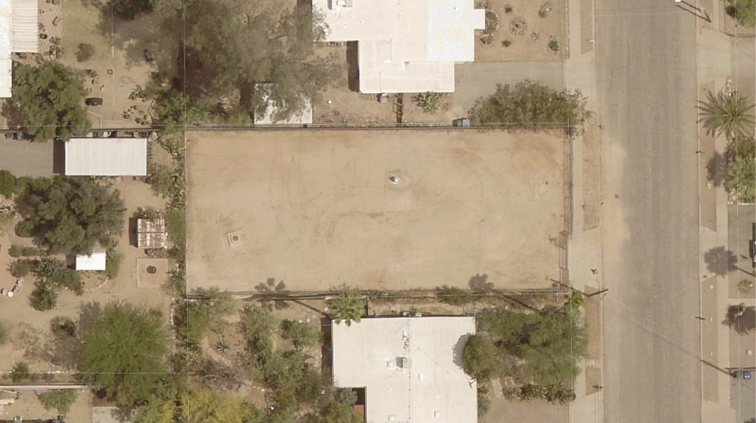
5,000 GALLON HYDRO TANK WITH AIR COMPRESSOR
LANDSCAPE BORDER WITH MESQUITE TREE AND OTHER DROUGHT-TOLERANT SHRUBS AND GROUNDCOVERS
CHAIN-LINK FENCE WITH PRIVACY SLATS
CONTROL BUILDING
(100 SF)

Slide 6
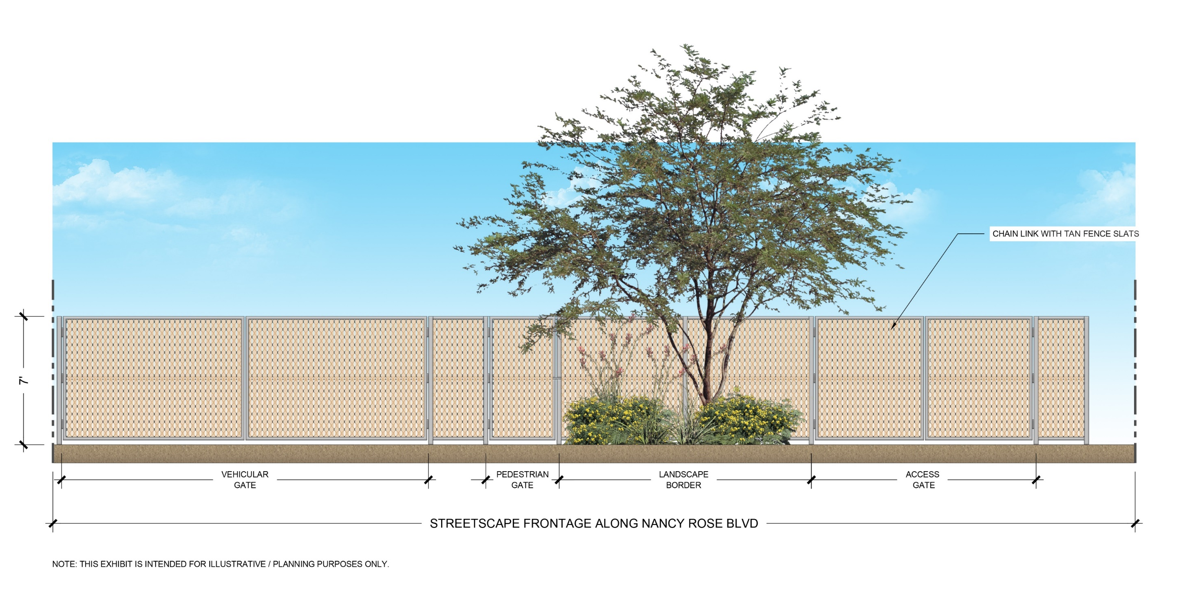
NANCY ROSE BLVD STREETSCAPE (PROPOSED)

Slide 7
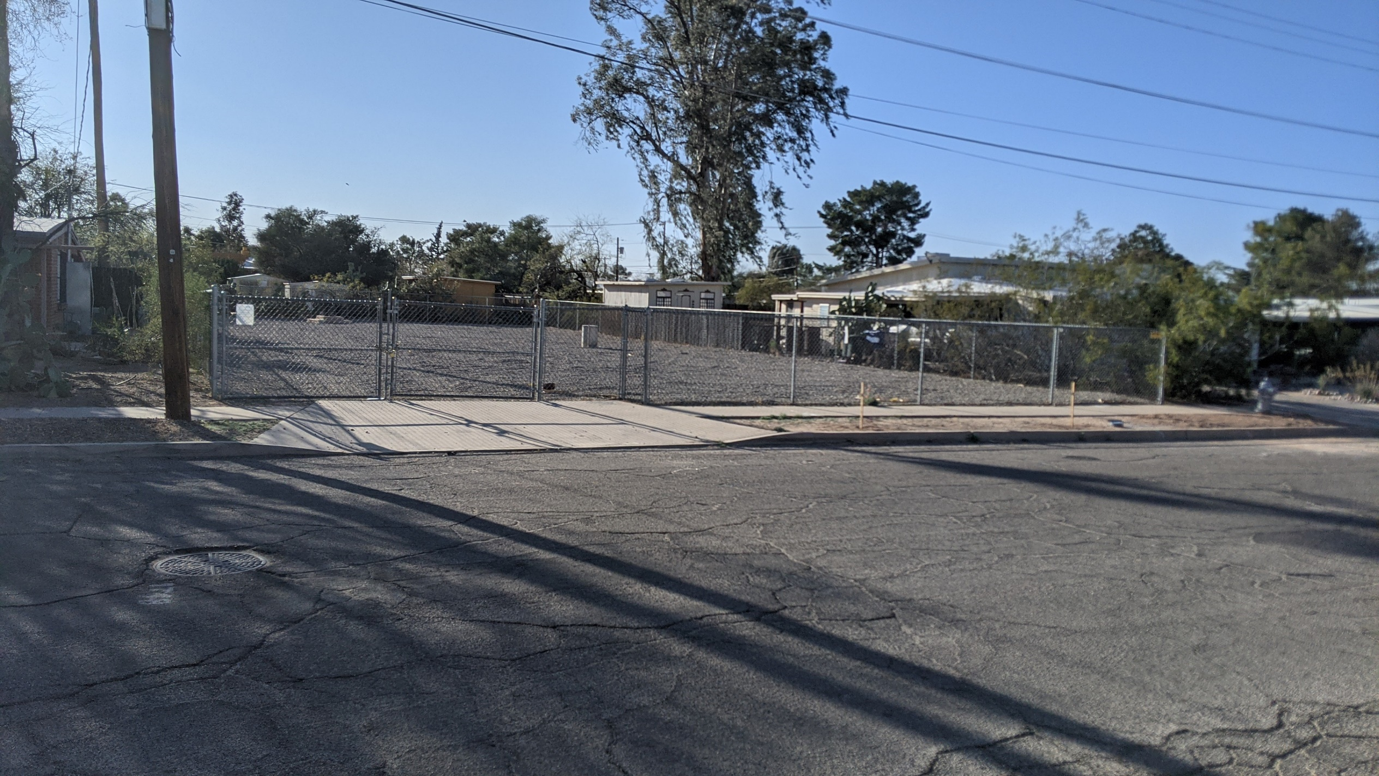
NANCY ROSE BLVD STREETSCAPE (CURRENT)

Slide 8
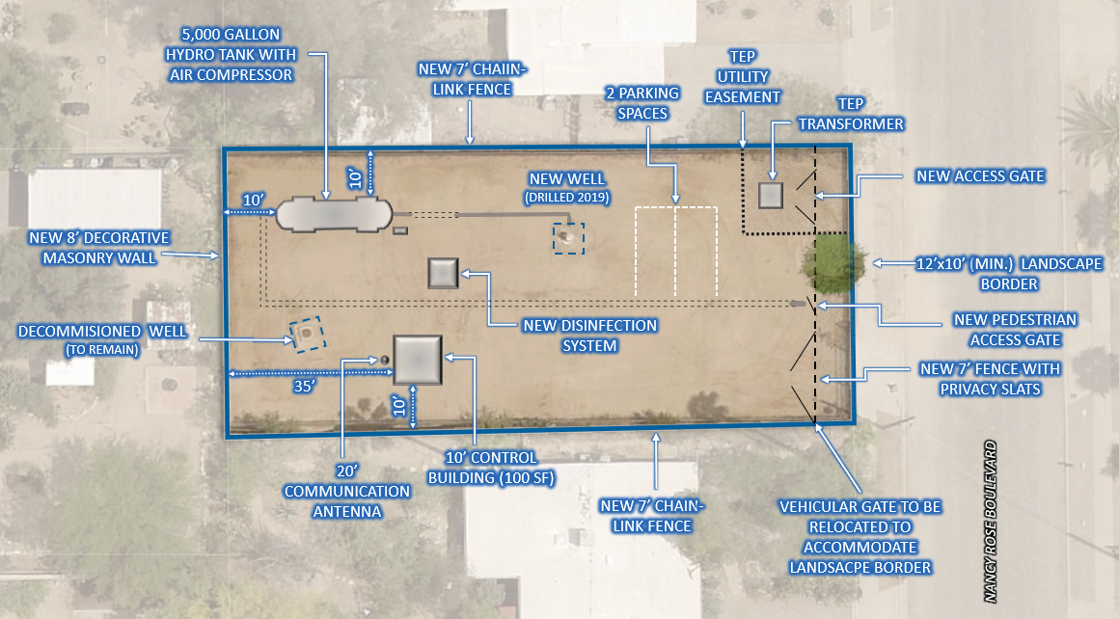
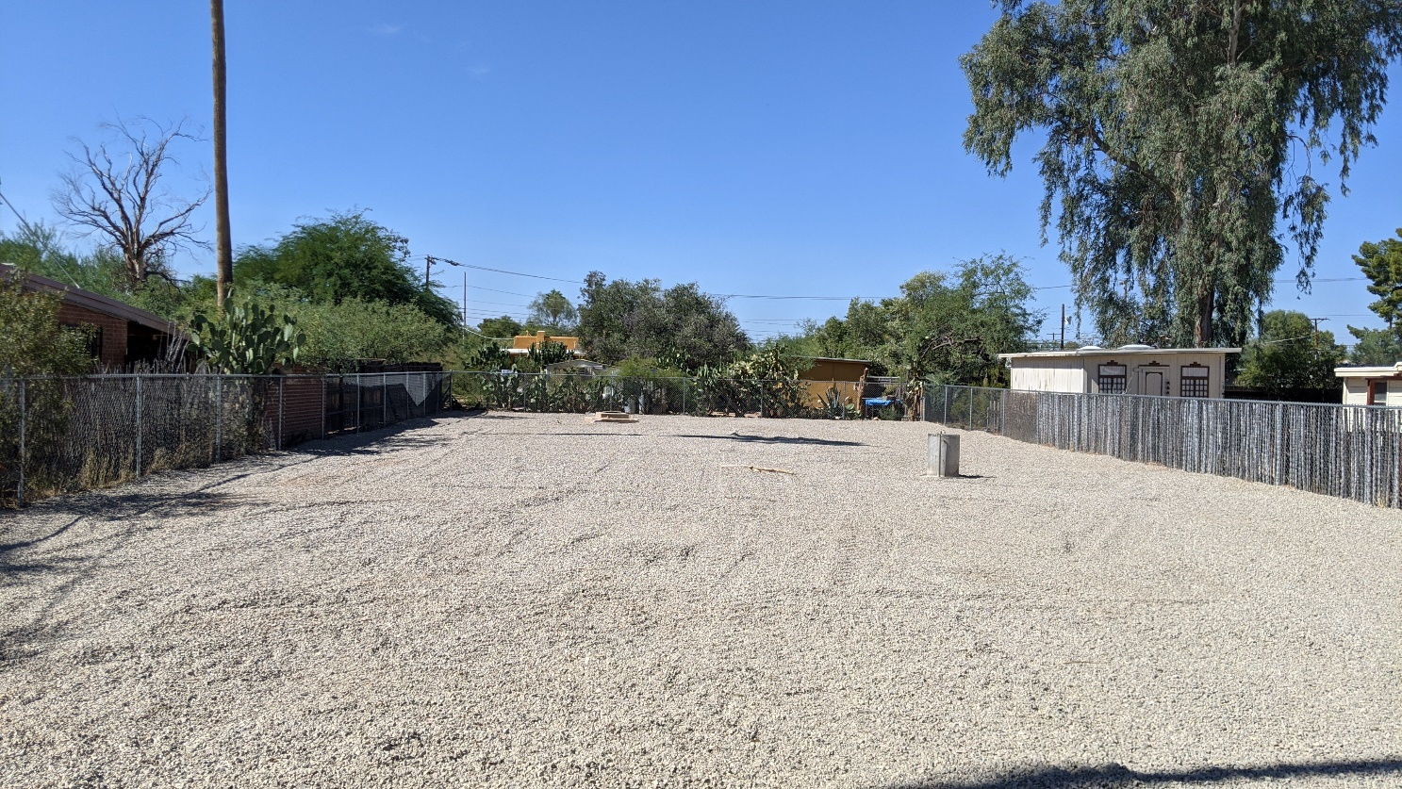
PROJECT SUMMARY
Tucson Water is requesting a Special Exception to equip the new well that was drilled on the property in 2019
The improvements consist of the installation of:
100 SF control building (max. height 10’)
Communication antenna (max. height 20’)
5,000 GAL hydro tank with air compressor
Landscaping along Nancy Rose Boulevard
Screening (7’ chain-link fence / 8’ masonry wall)
TEP transformer
Pipes and other equipment necessary for the well to function
Requesting an exception to use-specific standards:
The setback of the facility, including walls or equipment, shall be 20 feet from any adjacent residential zone
The use shall be located wholly within an enclosed building or within an area enclosed on all sides with a masonry wall or compact evergreen hedge, not less than six feet, nor more than ten feet, in height.

Slide 9
WELL B-052C SITE IMPROVEMENTS 1937 North Nancy Rose Boulevard
QUESTIONS???

